Slide 1
Tutorial-1

Slide 2
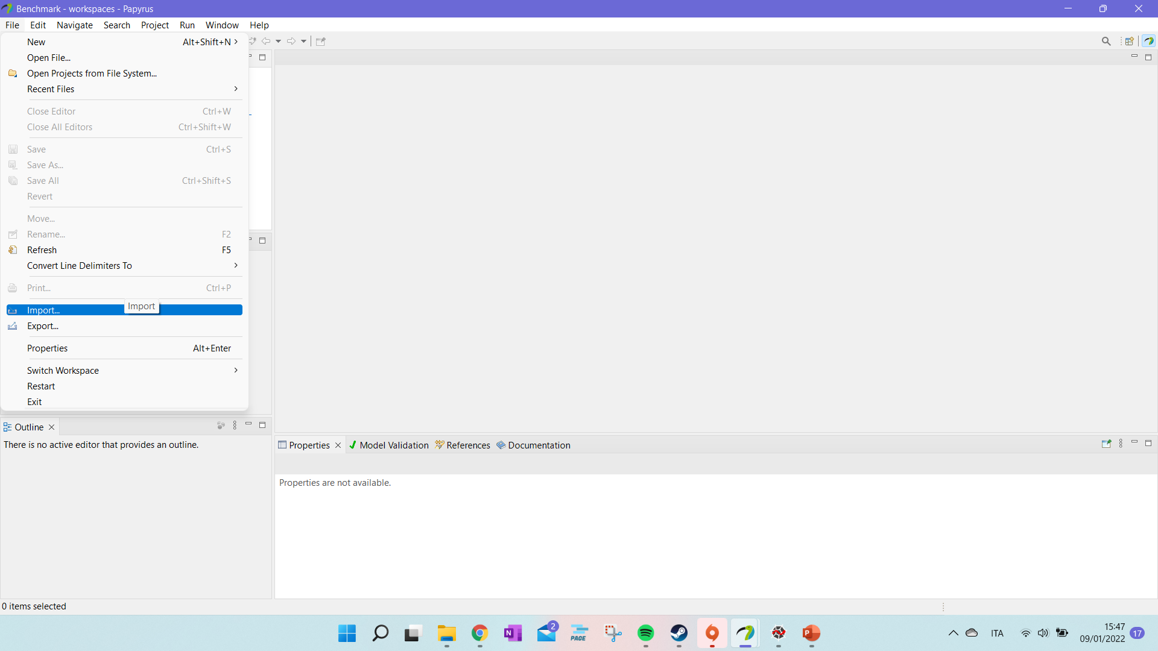
Tutorial: Import Sample Project (i)
Start with going to “File” and then “import” to set your workspace with the template for the HDDL translation.

Slide 3
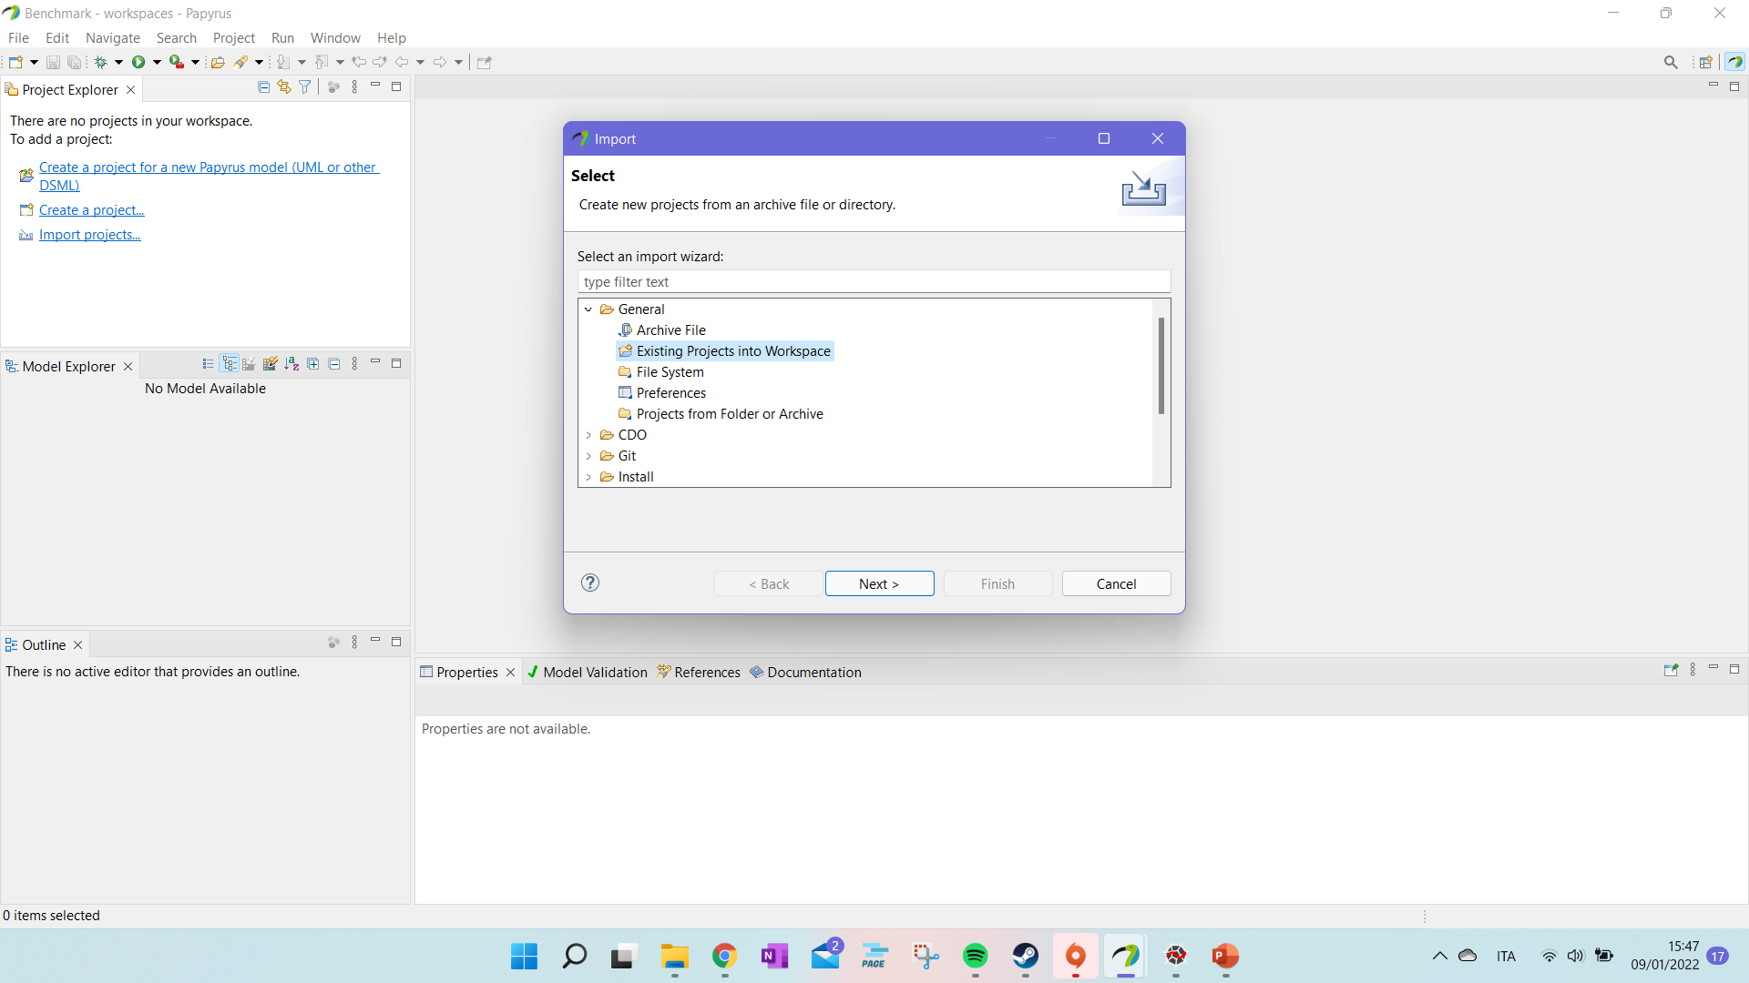
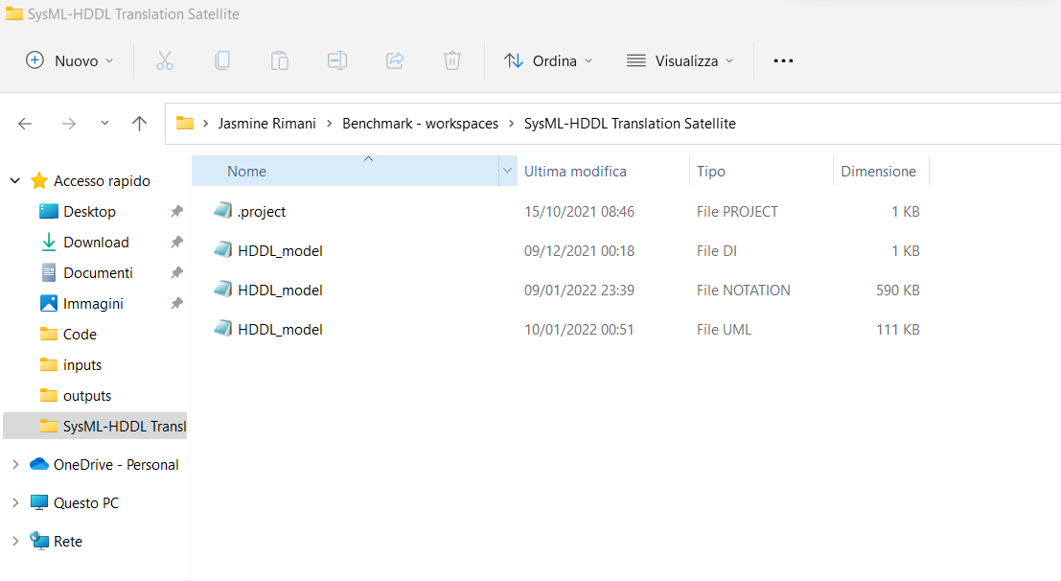
Tutorial: Import Sample Project (ii)
The workspace to import should be in the folder of your papyrus workspace. You can just copy paste the template folder in your papyrus workspace.

Slide 4
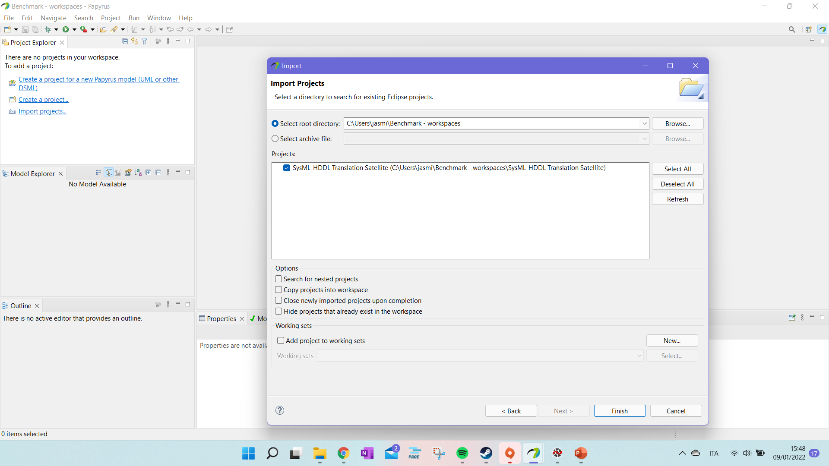
Tutorial: Import Sample Project (iii)
The workspace to import should be in the folder of your papyrus workspace. You can just copy paste the template folder in your papyrus workspace.

Slide 5
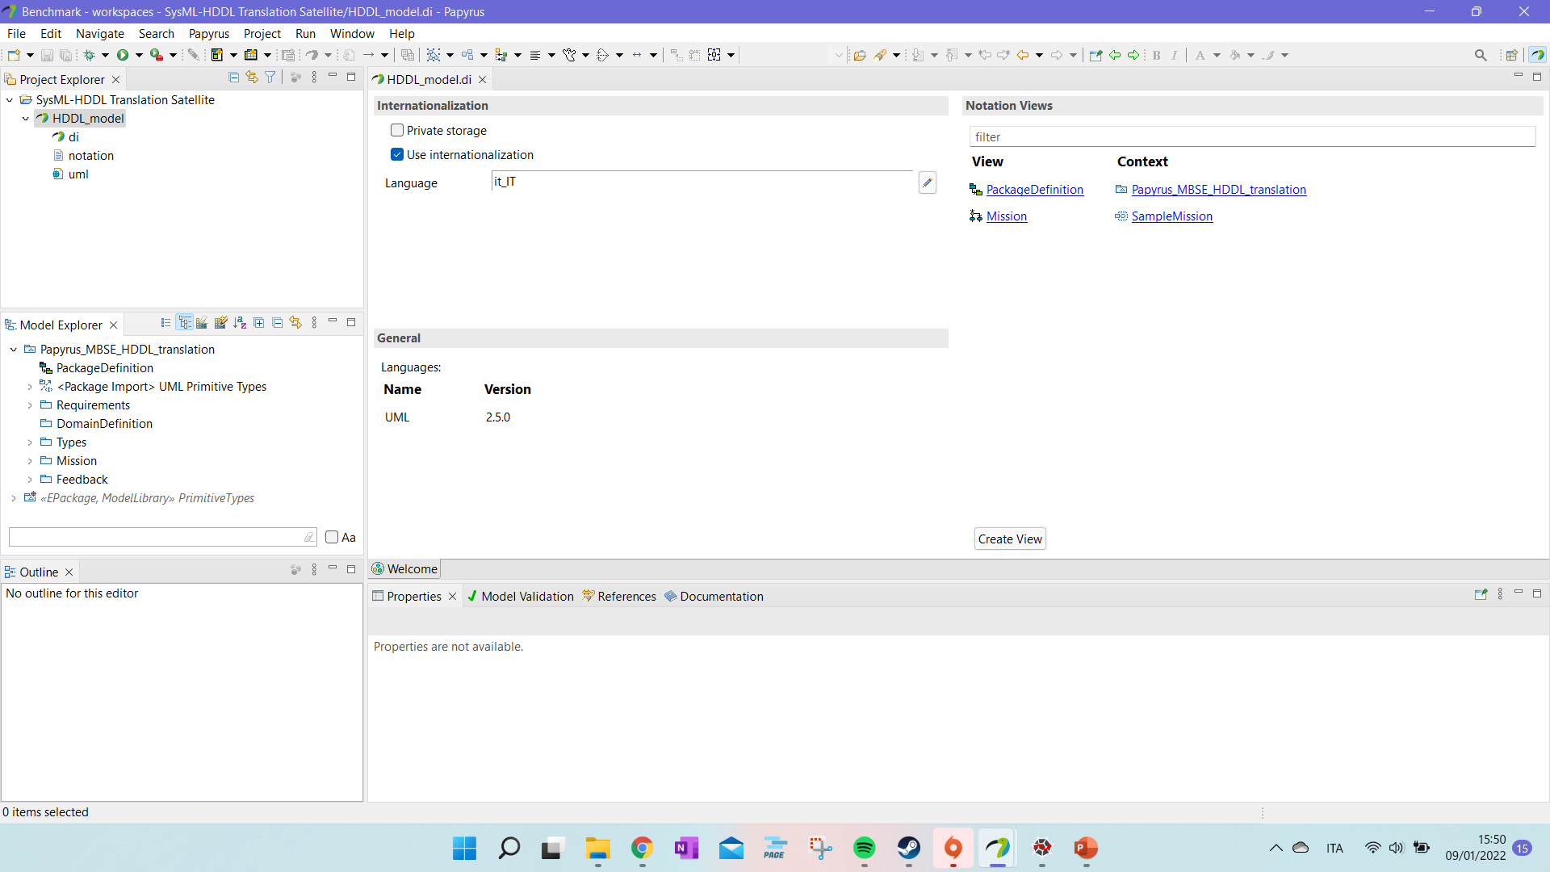
Tutorial: Import Sample Project (iv)
Now your workspace is set. We can start with the modelling.

Slide 6
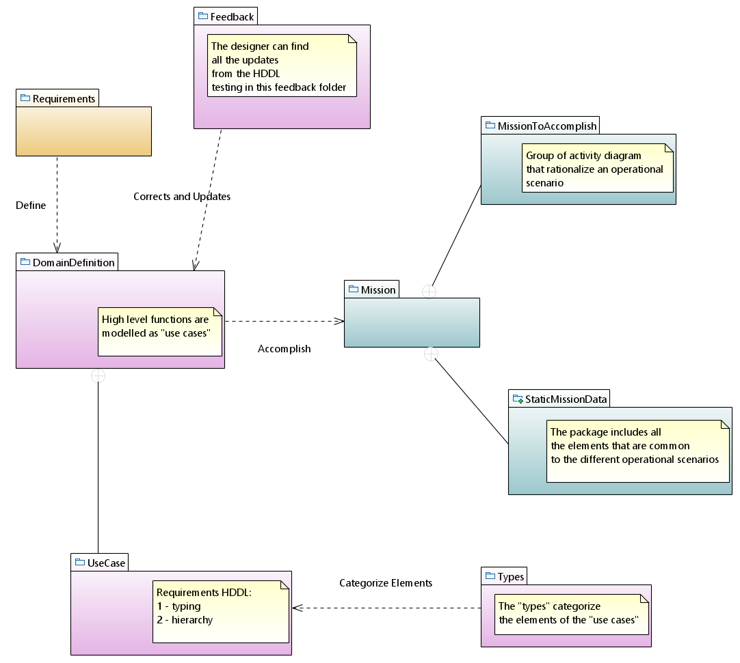
Tutorial: Import Sample Project (iv-bis)
This should be the structure of your folder in the template workspace.

Slide 7
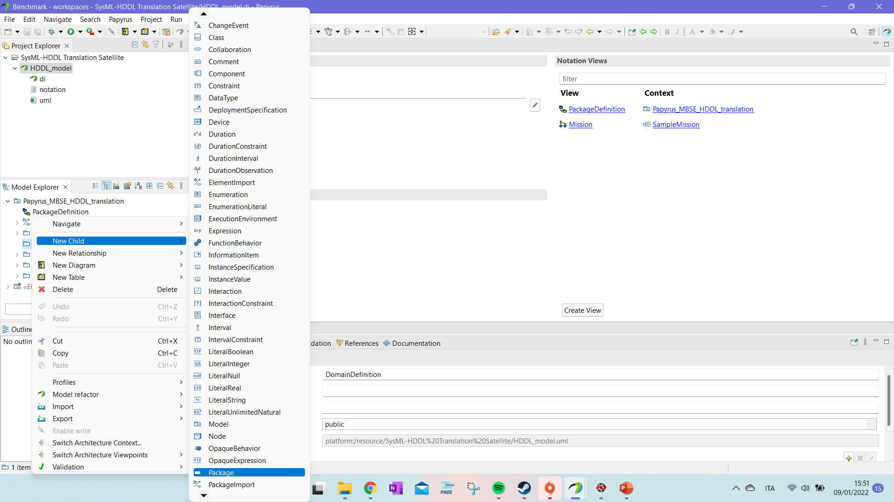
Tutorial: Missing UseCase Package
If you don’t see a “UseCase” package inside “DomainDefinition” you can set it manually.

Slide 8
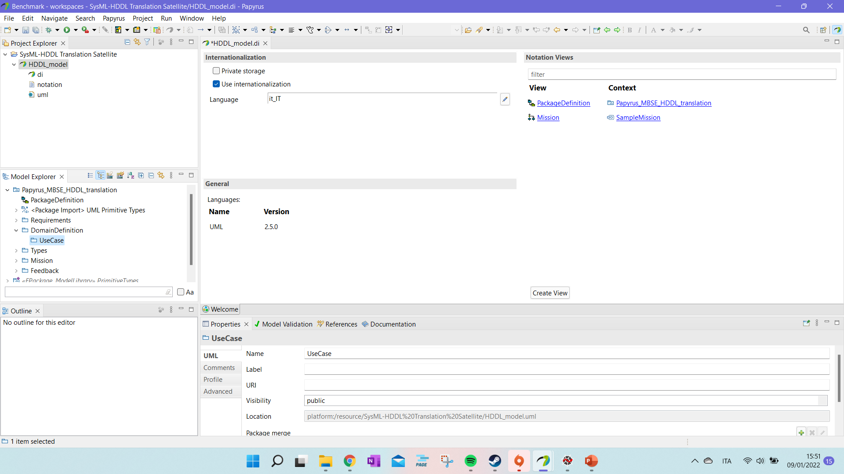
Tutorial: Missing UseCase Package (ii)
If you don’t see a “UseCase” package inside “DomainDefinition” you can set it manually.

Slide 9
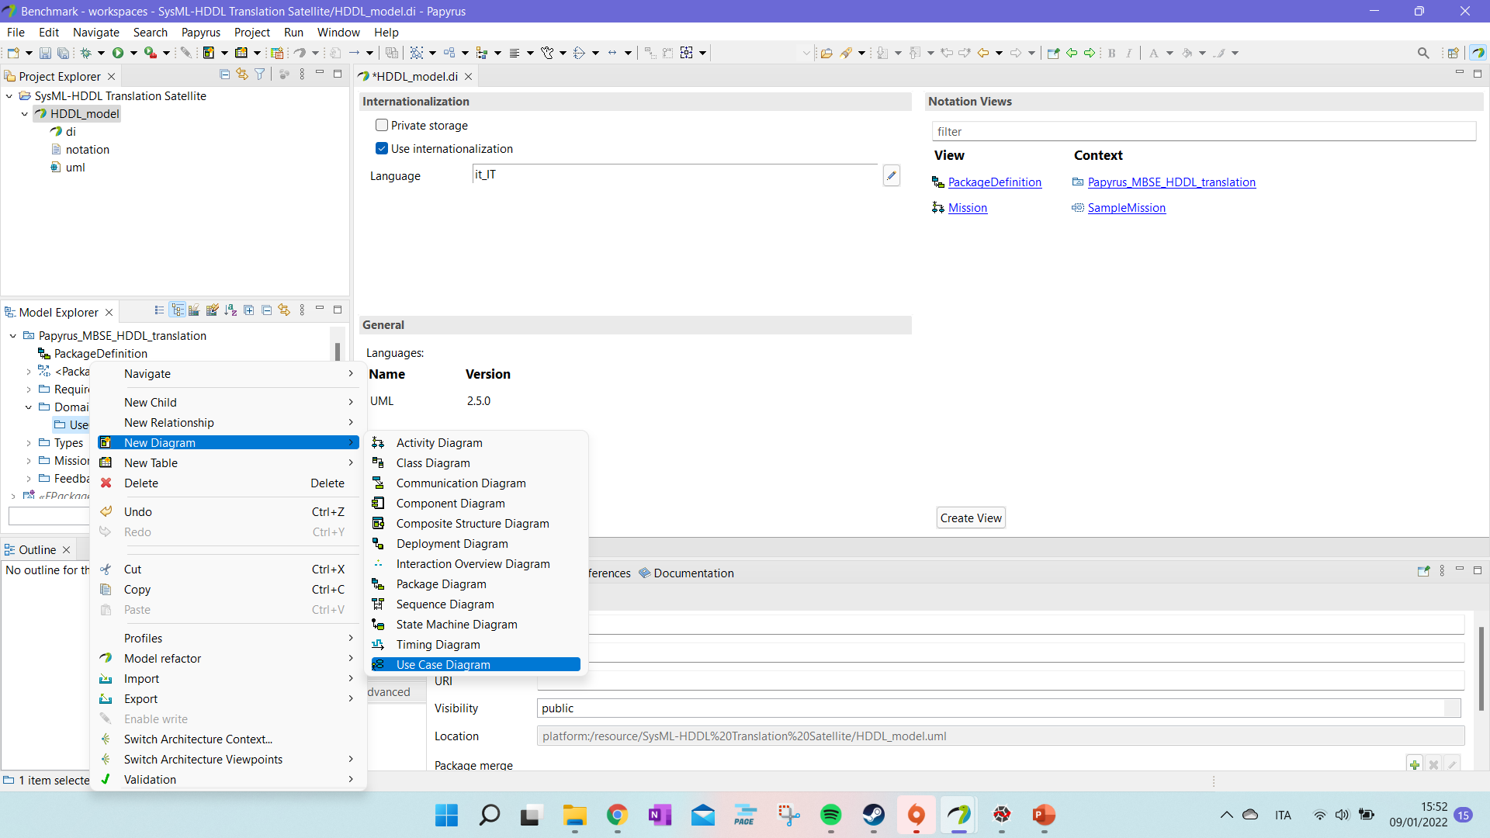
Tutorial: start setting the first diagram
The first diagram that we are going to use is the “UseCase” diagram.
We right click on the UseCase package and define a new diagram.
It will permit to perform the functional analysis on the system.
We will define what the system should do, “tasks”, and “how” it can do it “methods”.

Slide 10
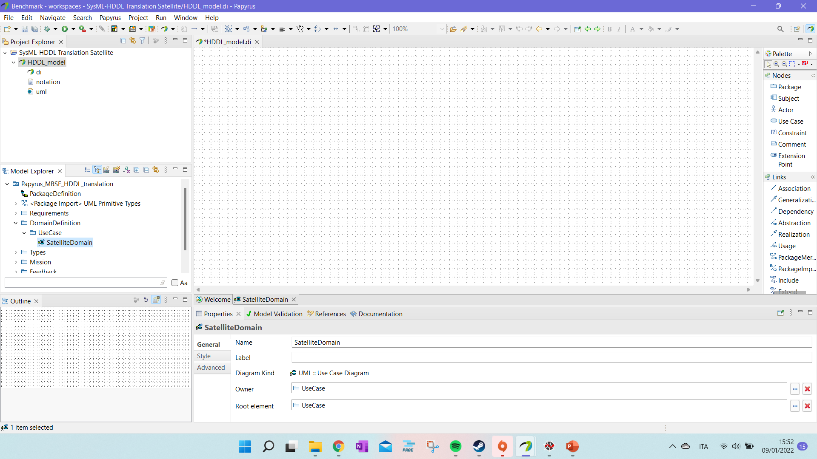
Tutorial: start setting the first diagram (ii)
We now have the UseDiagram pallete that we can use to study our systems.
For the real analysis only the task and methods defined as UseCases and the comment on the domain requirements are used.
All the other elements are not analysed in the tool and they are needed just to simplify the study of the problem and give a visual help to however is looking at the models.
We will model the satellite benchmark of https://github.com/panda-planner-dev/ipc2020-domains/blob/master/total-order/Satellite-GTOHP/p01.hddl

Slide 11
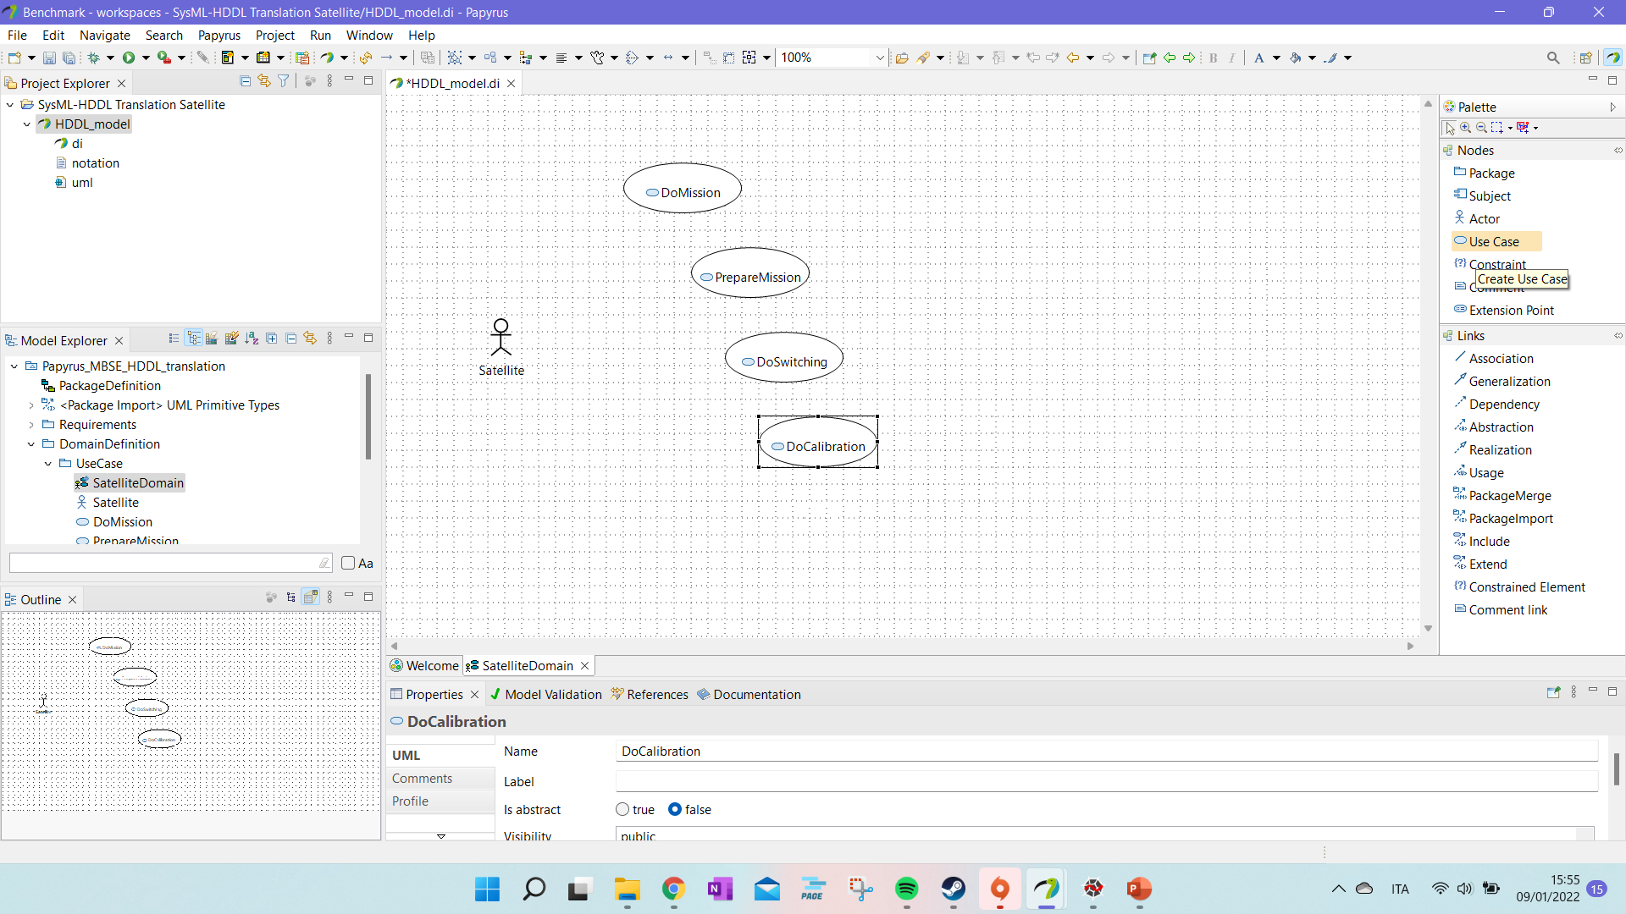
Tutorial: UseCase Diagram
We define our main system or systems as “actor” and then we start defining the functions that we expect them to perform at high level. Those will be our “:tasks” in HDDL.

Slide 12
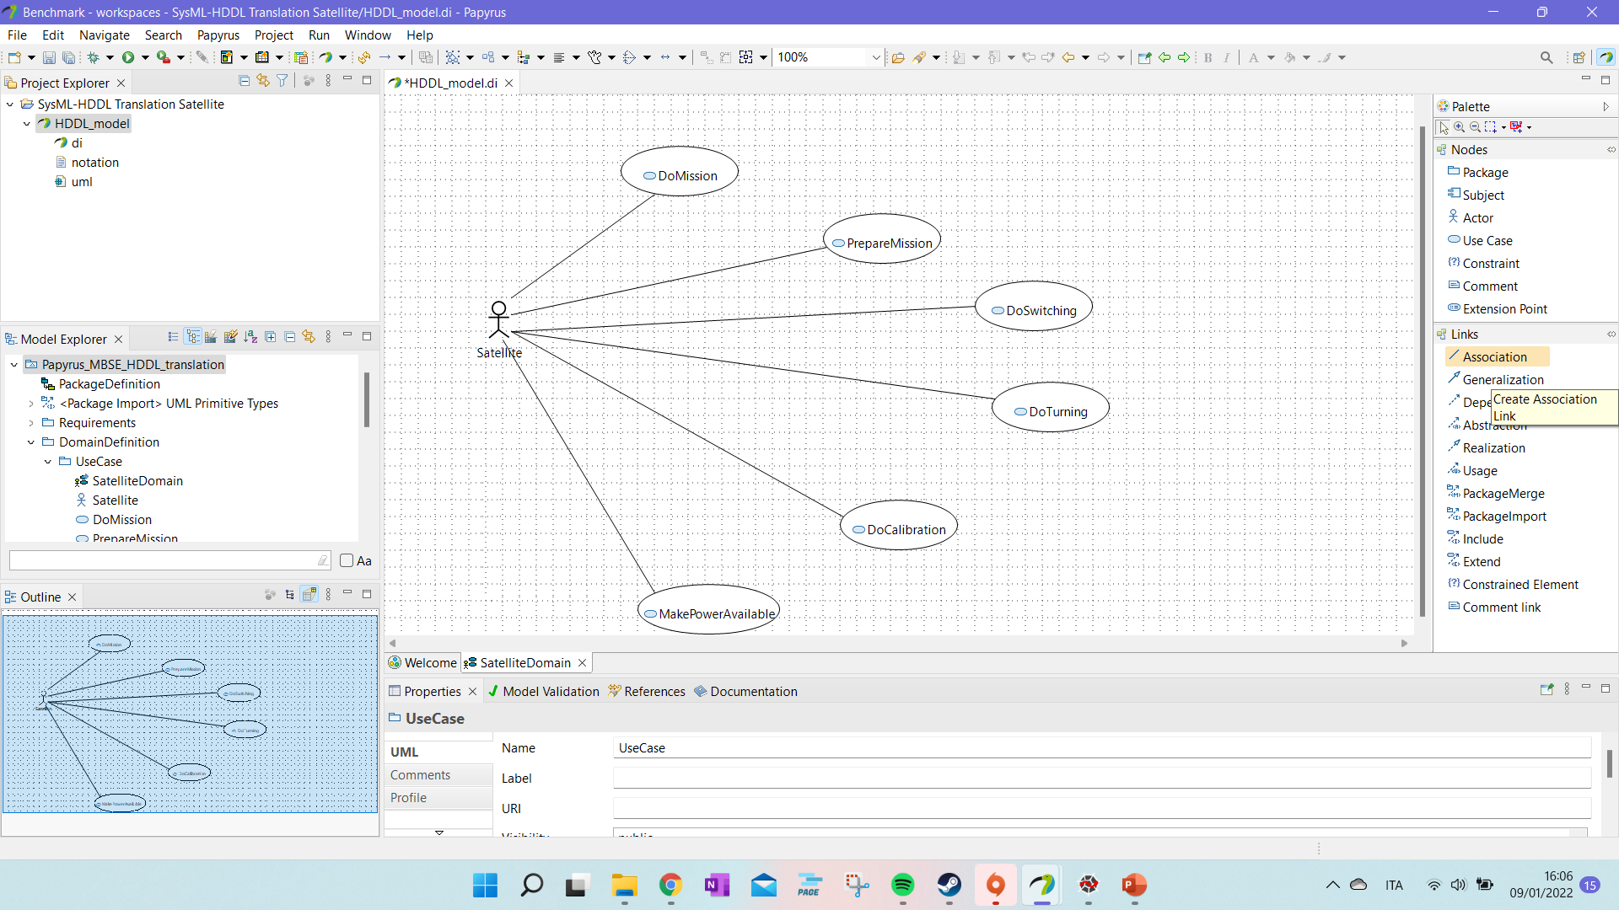
Tutorial: UseCase Diagram (ii)
We can link the different UseCases to our main actor.
However, it is not required for the translation software. It is just a visual aid.
The link is made using the “Association” link.

Slide 13
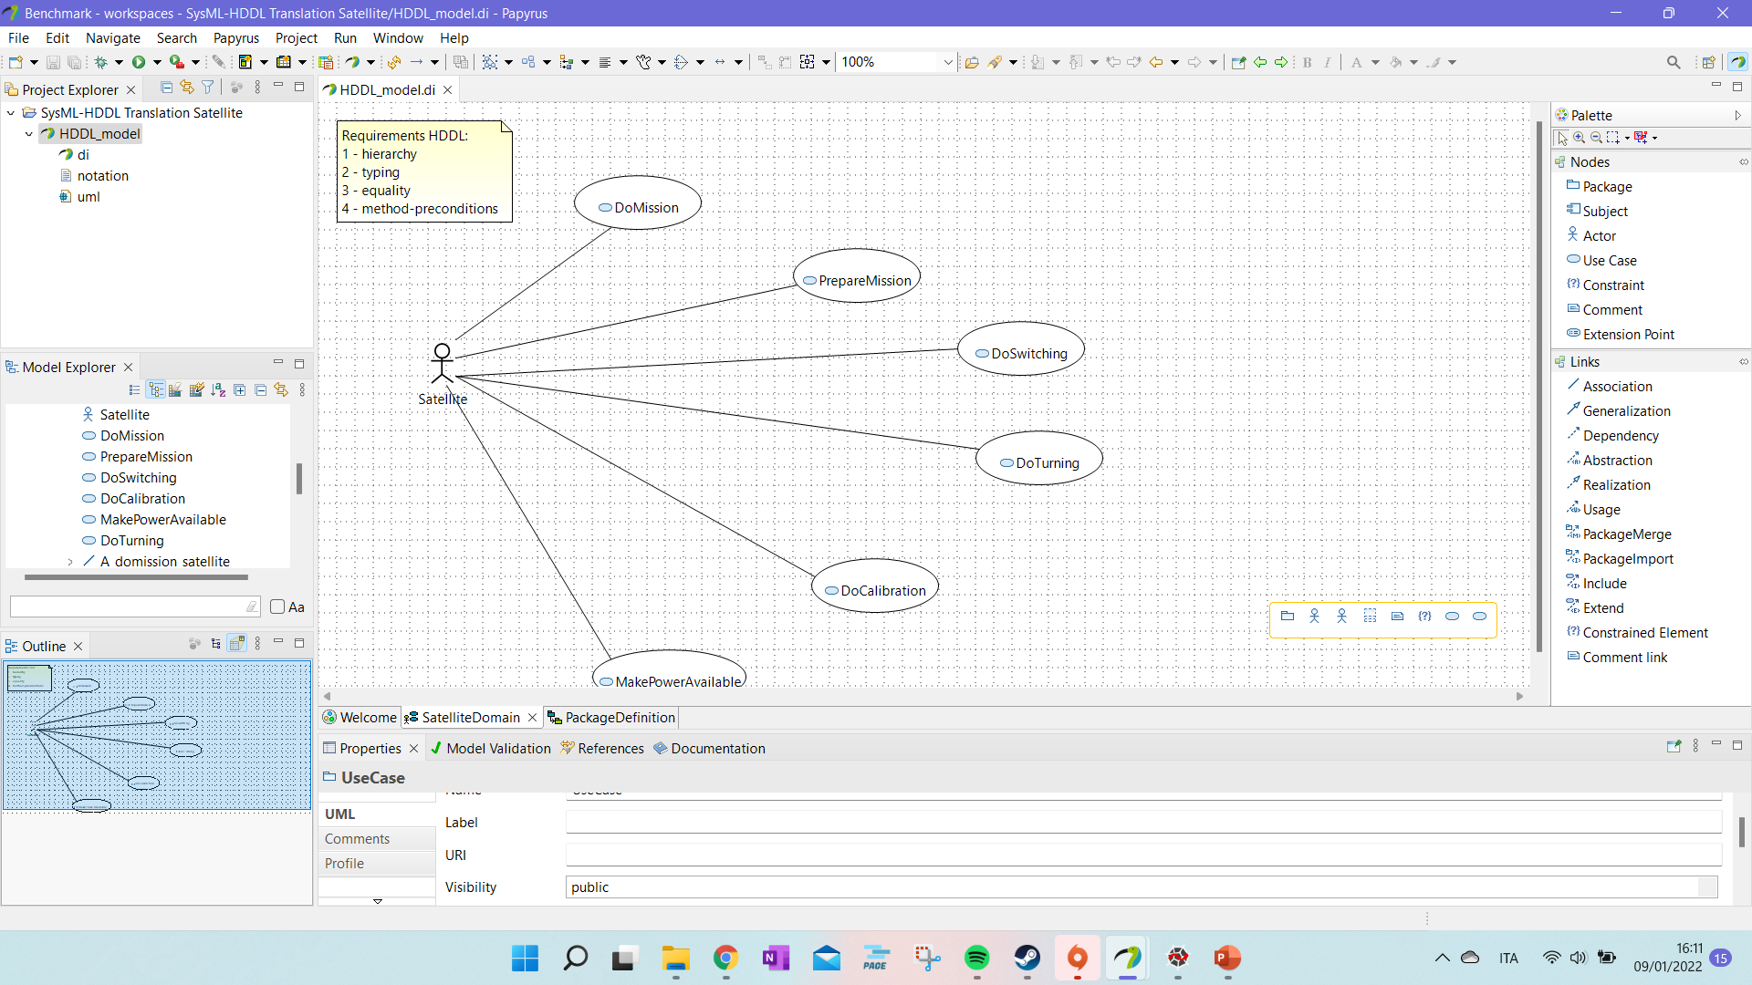
Tutorial: UseCase Diagram (iii)
We can define as comment the HDDL domain requirements.
The initial “Requirements HDDL” should be as first line of the comment. The program search for the world “Requirements” to consider the comment.
In case the user can add the requirements directly in the HDDL file.

Slide 14
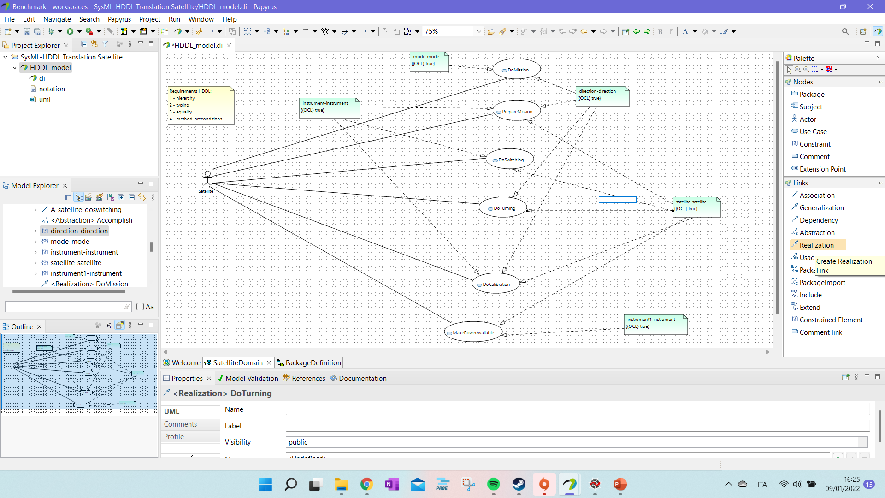
Tutorial: Use Case Diagram (iv)
The task parameters can be inserted as constraints (“Constraints”) and linked and linked to the Use cases with the “realization” or “dependency” links.
As for the SysML specification, we should define those entries as parameters, so we need to change that opaque expression to parameter – to see how please check the next slides.

Slide 15
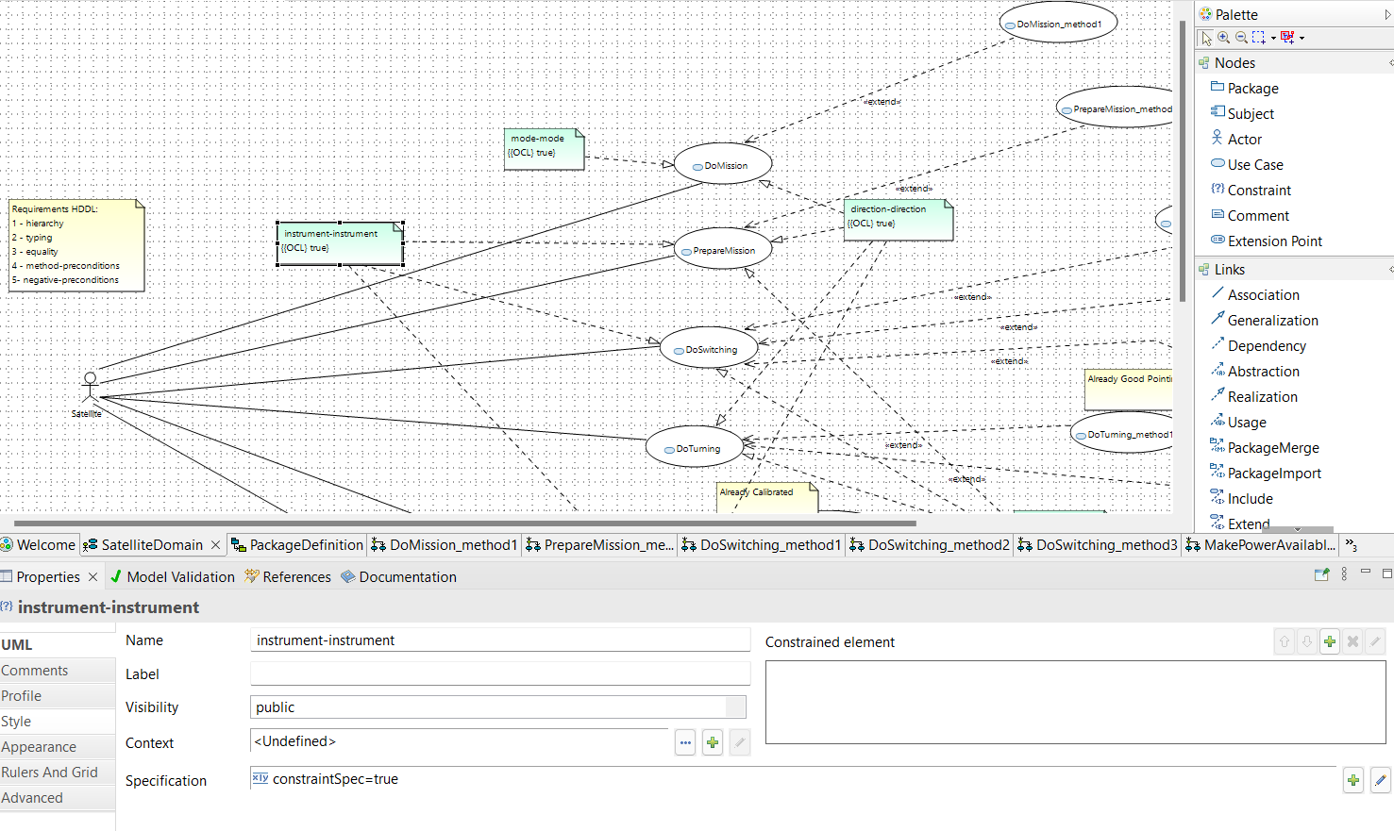
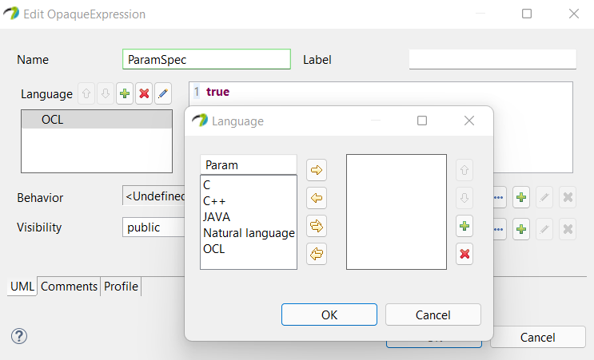
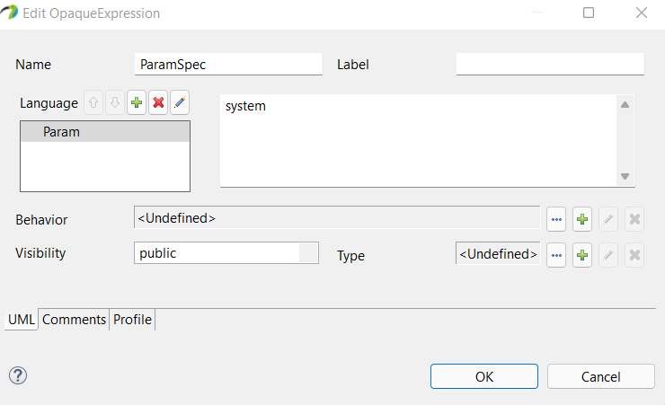
Tutorial: Use Case Diagram (iv).b
Go to “Specification” inside the constraints detail and change the constraint from constraintSpec to ParamSpec.
Create or select Param as language and define you parameter in the section nearby.

Slide 16
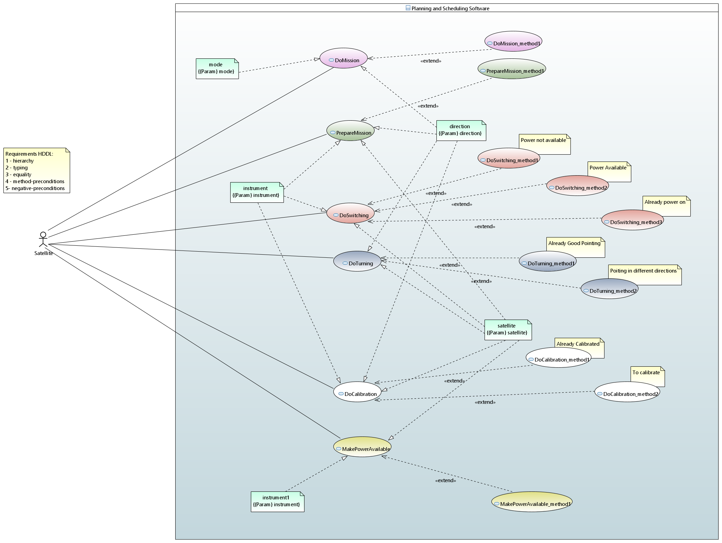
Tutorial: Use Case Diagram (iv).c

Slide 17
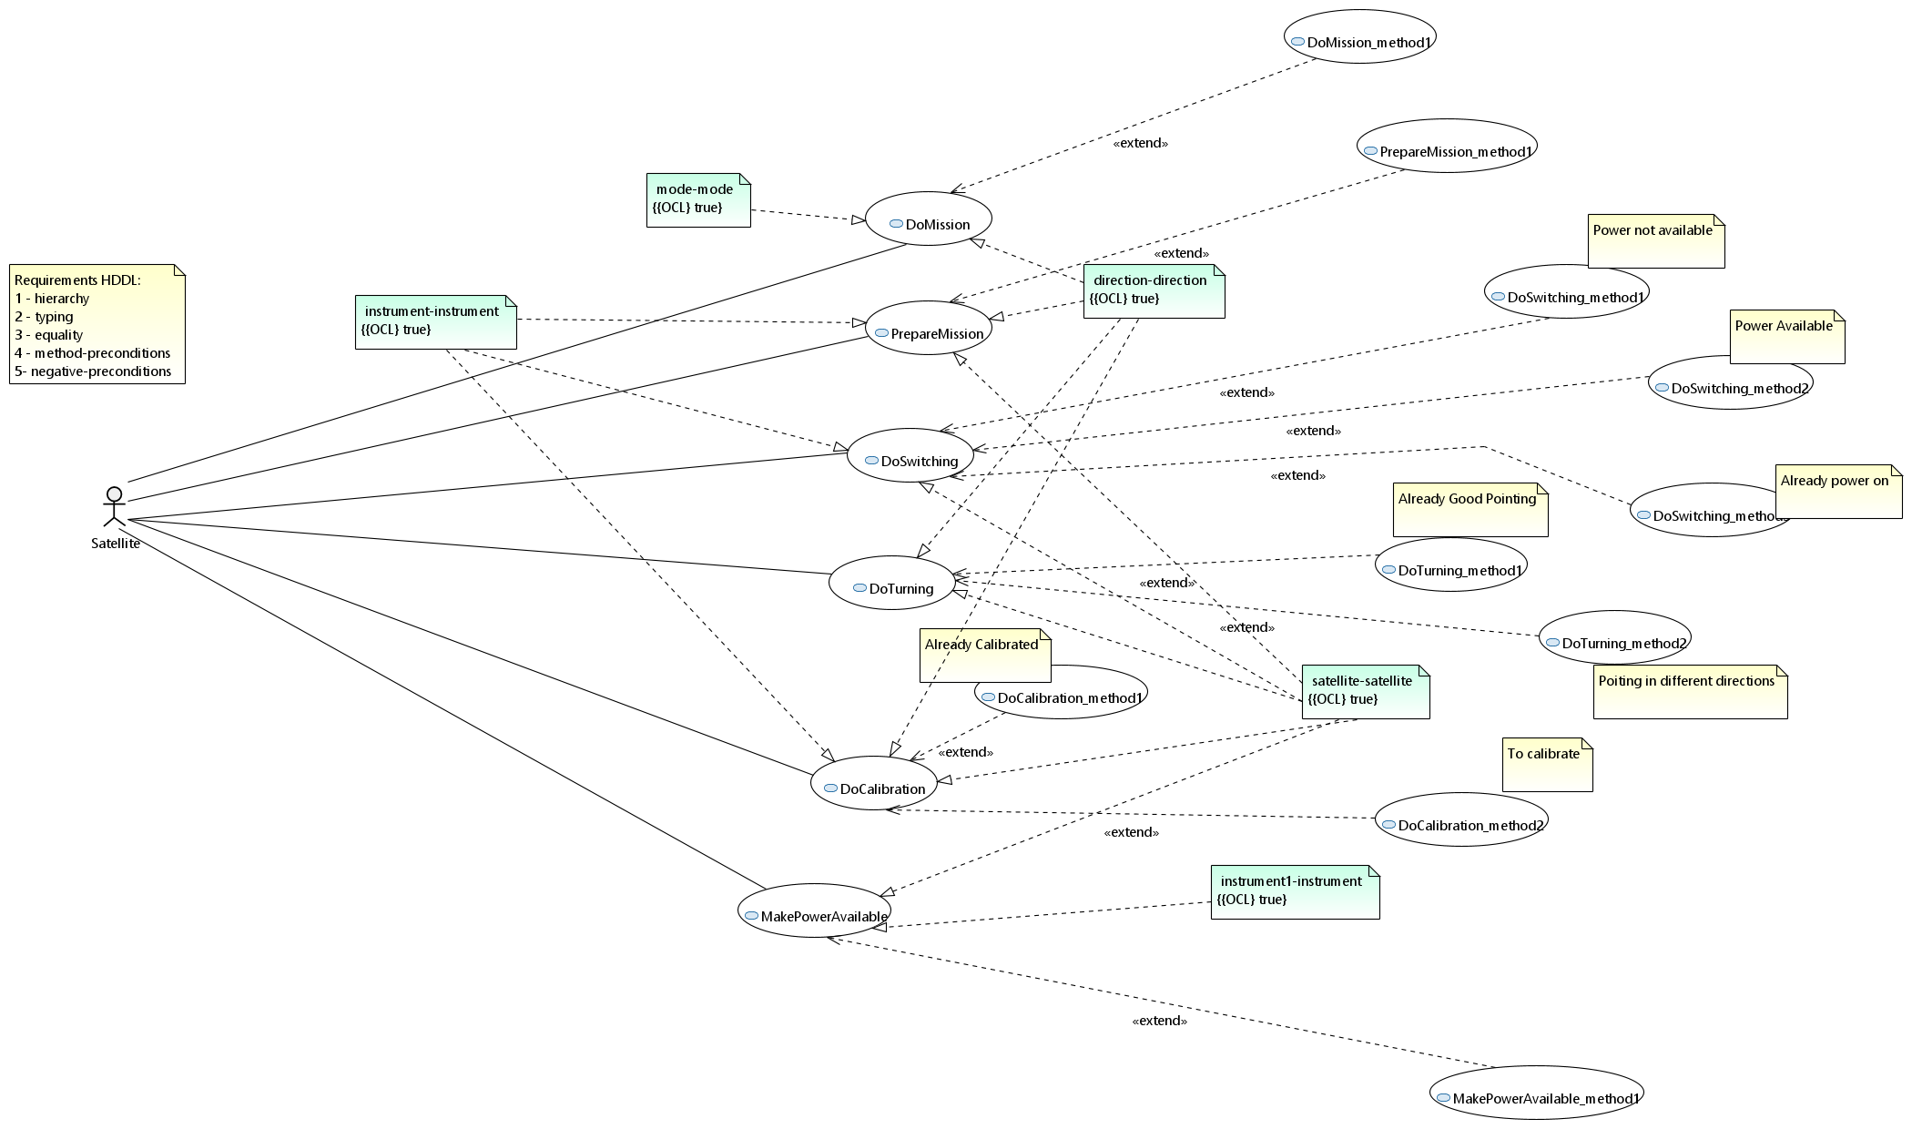
Tutorial: Use Case Diagram (vi)
Your result should look like this diagram!

Slide 18
Tutorial: Use Case Diagram (vi).b
Or like this if you defined your parameters as Param and if you added a system context to the Use Case diagram.
The system context is given to define the boundaries of the system or software or system of systems under study.

Slide 19
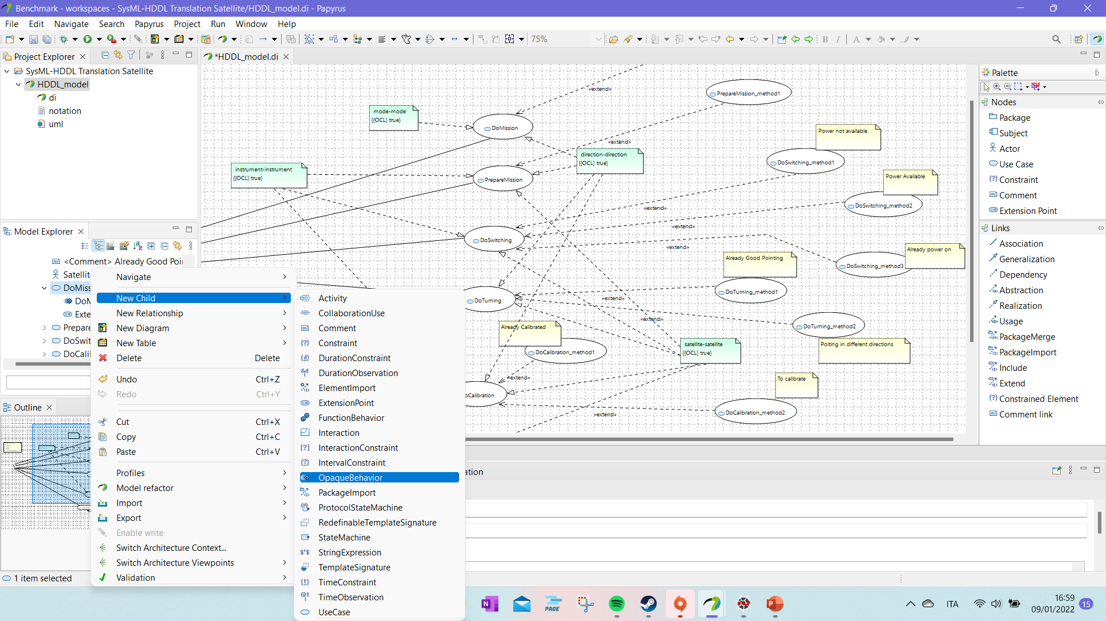
Tutorial: Define the tasks!
To each :task we associate a OpaqueBehavior with the same name.
That will permit to add the :task as an OpaqueAction in the “Activity Diagrams” of other tasks keeping the link.

Slide 20
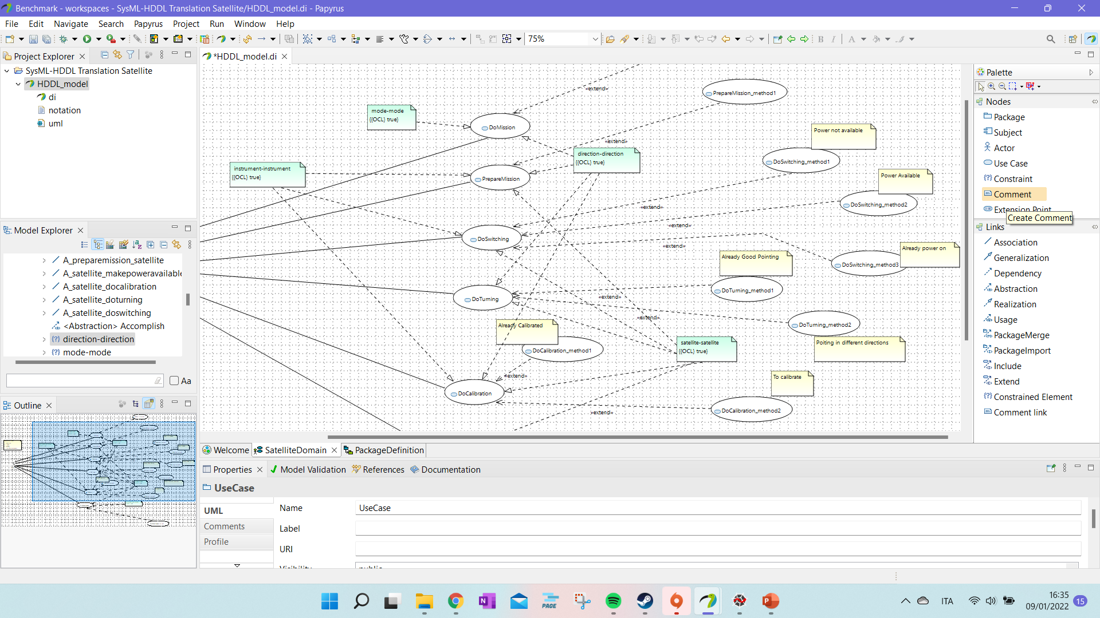
Tutorial: Use Case Diagram (v)
Then every :task UseCase can be associate to its methods.
The comments are used to understand what changes from one method to another of the same :task. They are there just for visualization and to help the designer.

Slide 21
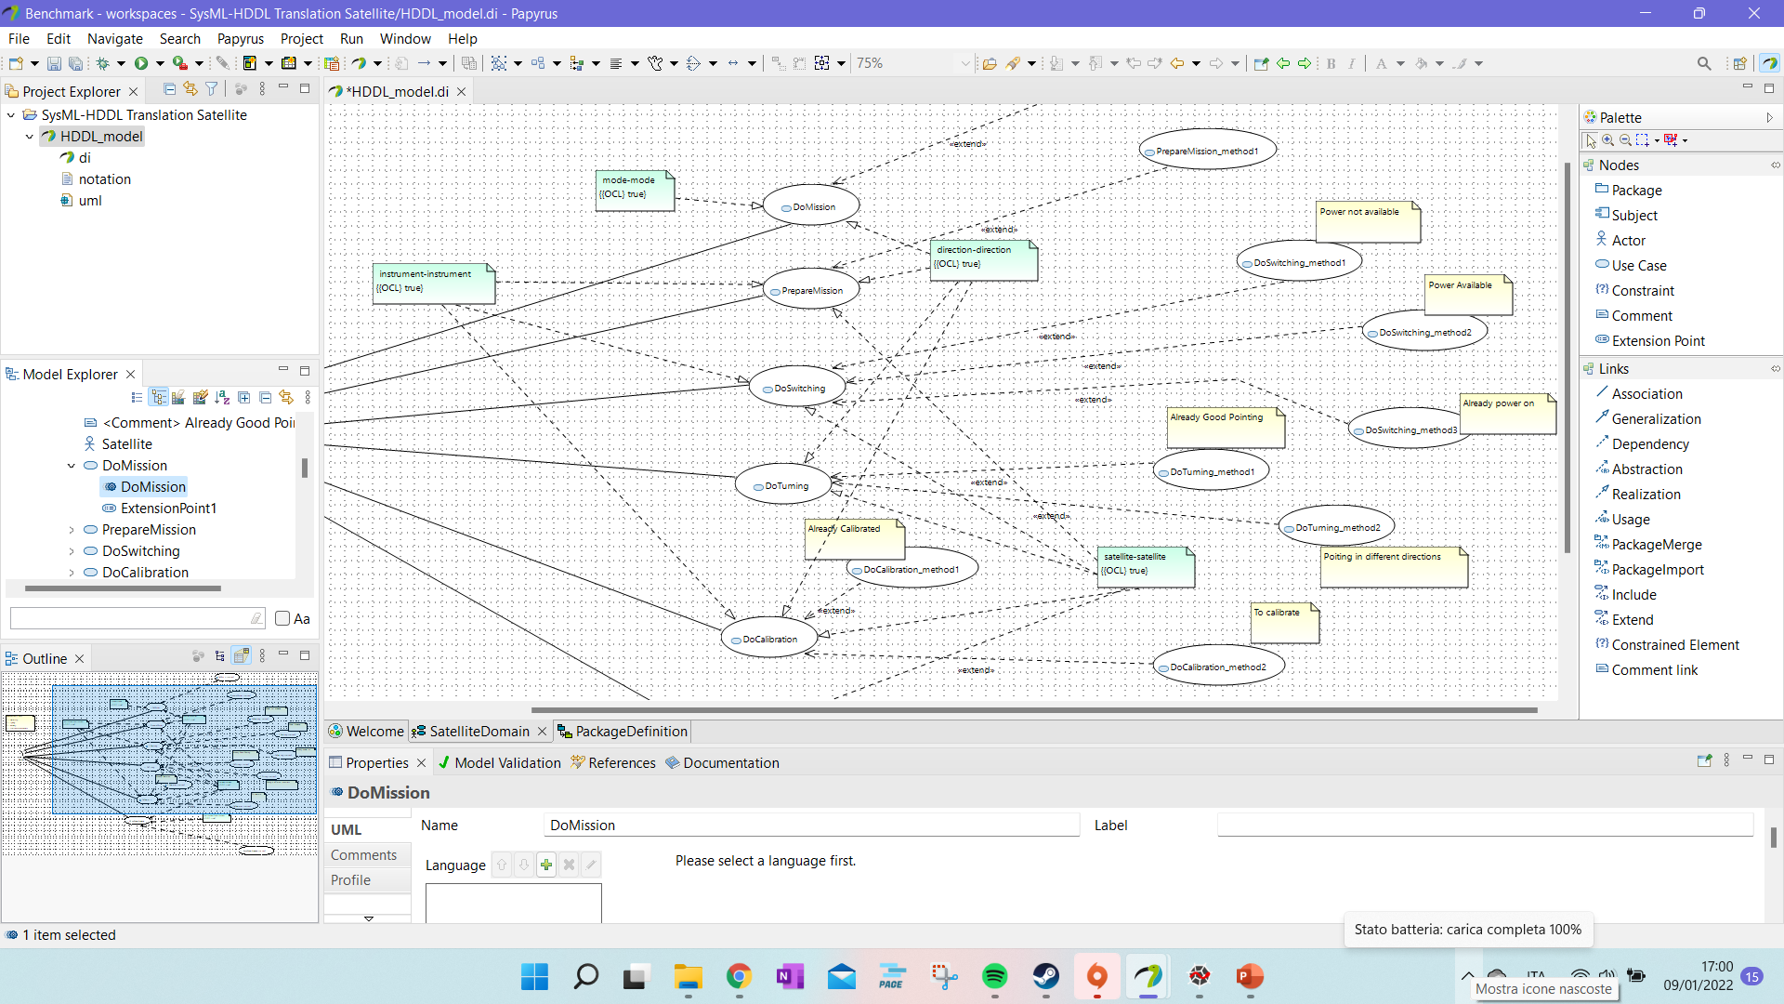
Tutorial: Define the tasks! (ii)
To each :task we associate a OpaqueBehavior with the same name.
That will permit to add the :task as an OpaqueAction in the “Activity Diagrams” of other tasks keeping the link.

Slide 22
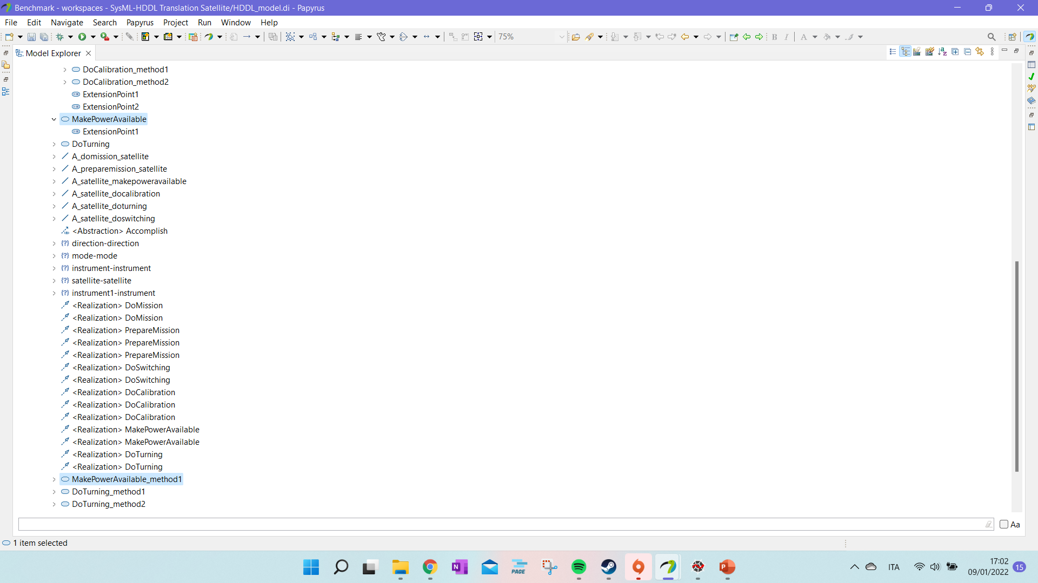
Tutorial: Define the tasks! (iii)
We need to check that all the methods are listed below their main task.
The tree visualization is used by BeautifulSoap ( https://beautiful-soup-4.readthedocs.io/en/latest/# ) to associate methods and tasks.

Slide 23
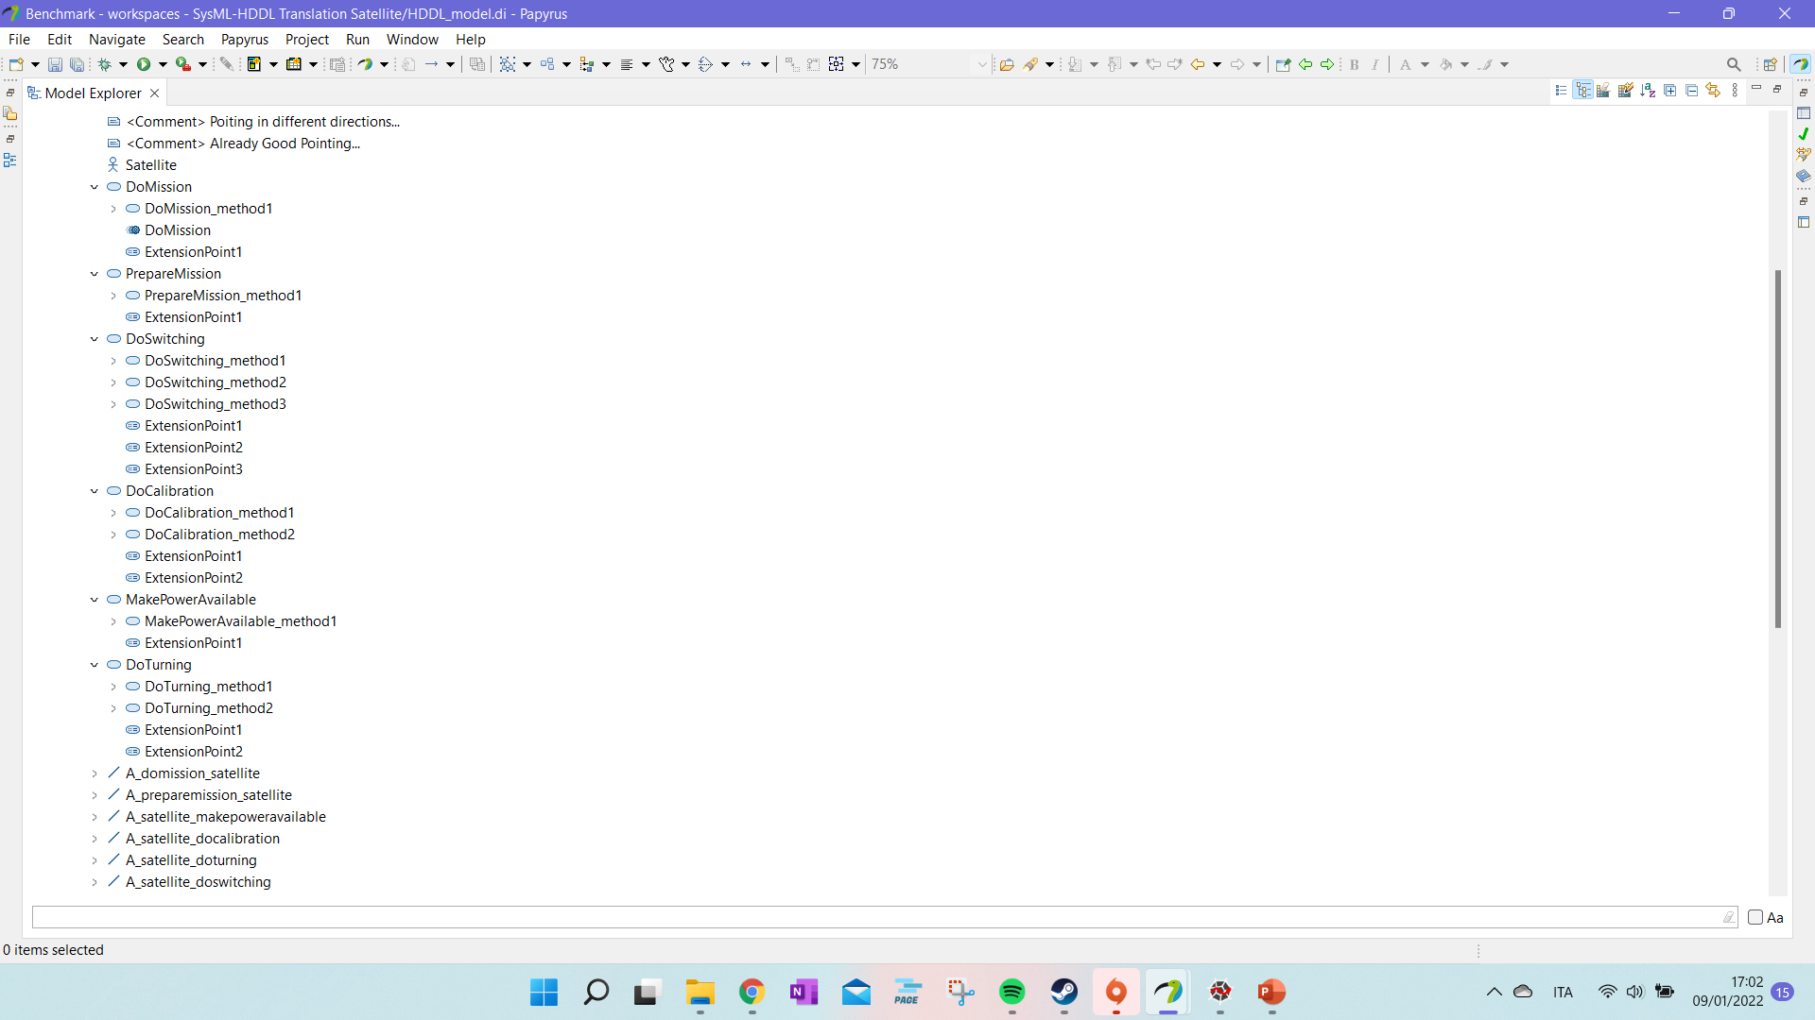
Tutorial: Define the tasks! (iv)
You should get something like this visualization with :task and their :methods nested.

Slide 24
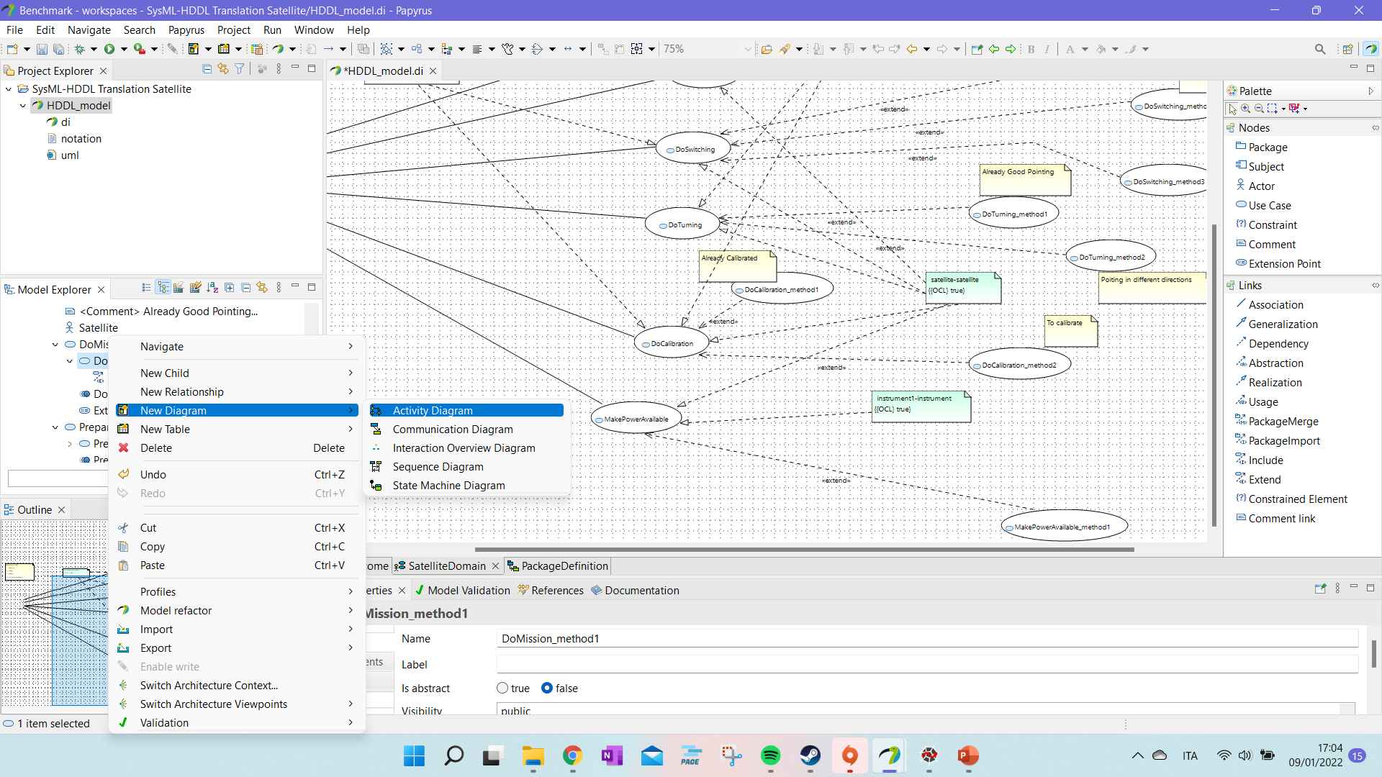
Tutorial: Define Methods
Now, for each method we define an “Activity Diagram”.
We create the diagram with a right click on the selected :method.

Slide 25
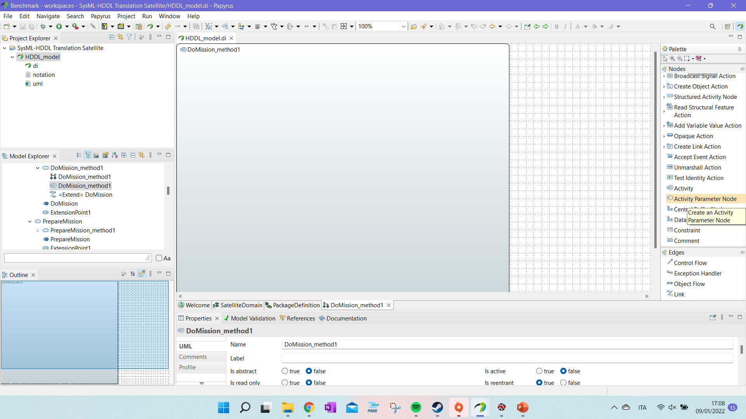
Tutorial: Define Methods (ii)
The best practice will be to name the “Activity Diagram” and the “Activity” with the same name of the :method. However, it is not enforced.
You may copy and paste the elements of one activity onto another one. It is possible – however to see it in the diagram you have to take it and drop it on the “Activity” canva.

Slide 26
Tutorial: Define Methods (ii)
The parameters and preconditions of the method can be inserted as “Activity Parameter Node”.

Slide 27
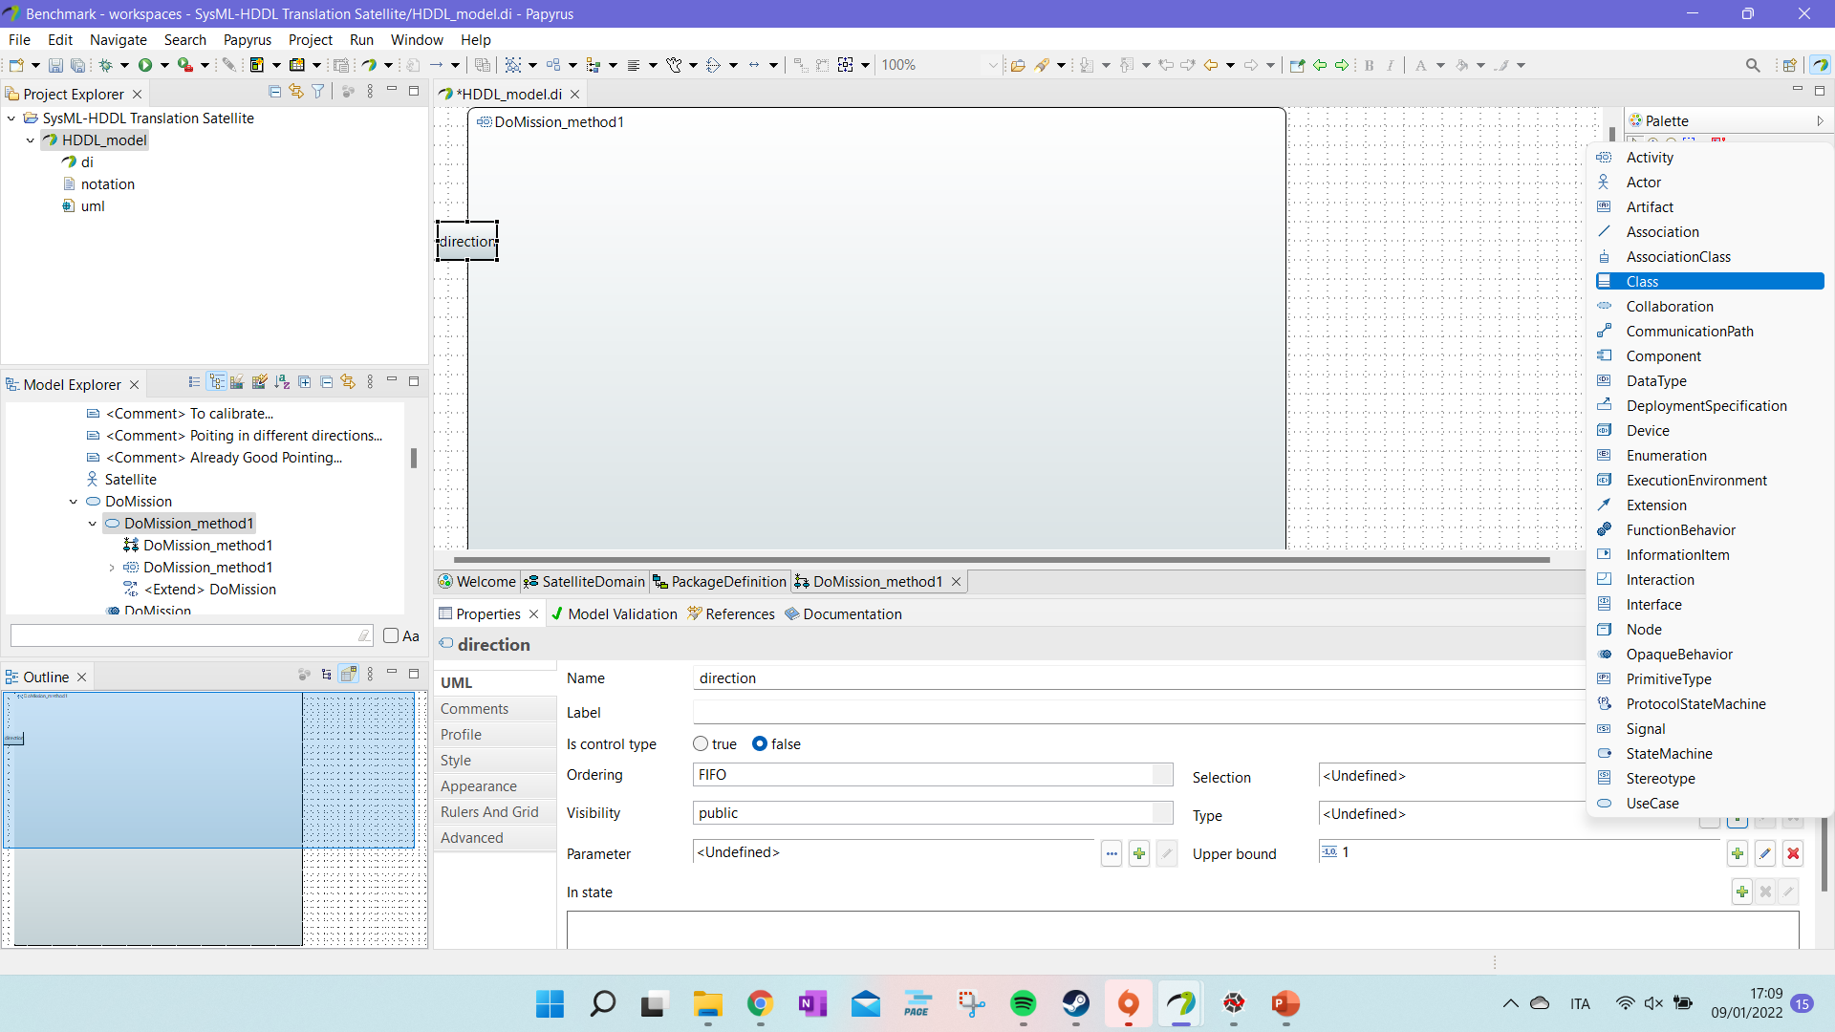
Tutorial: Define Methods (iii)
For each parameter, we give a :type defined as class.
To create a new “:type” we click on the “+” near “Type”.

Slide 28
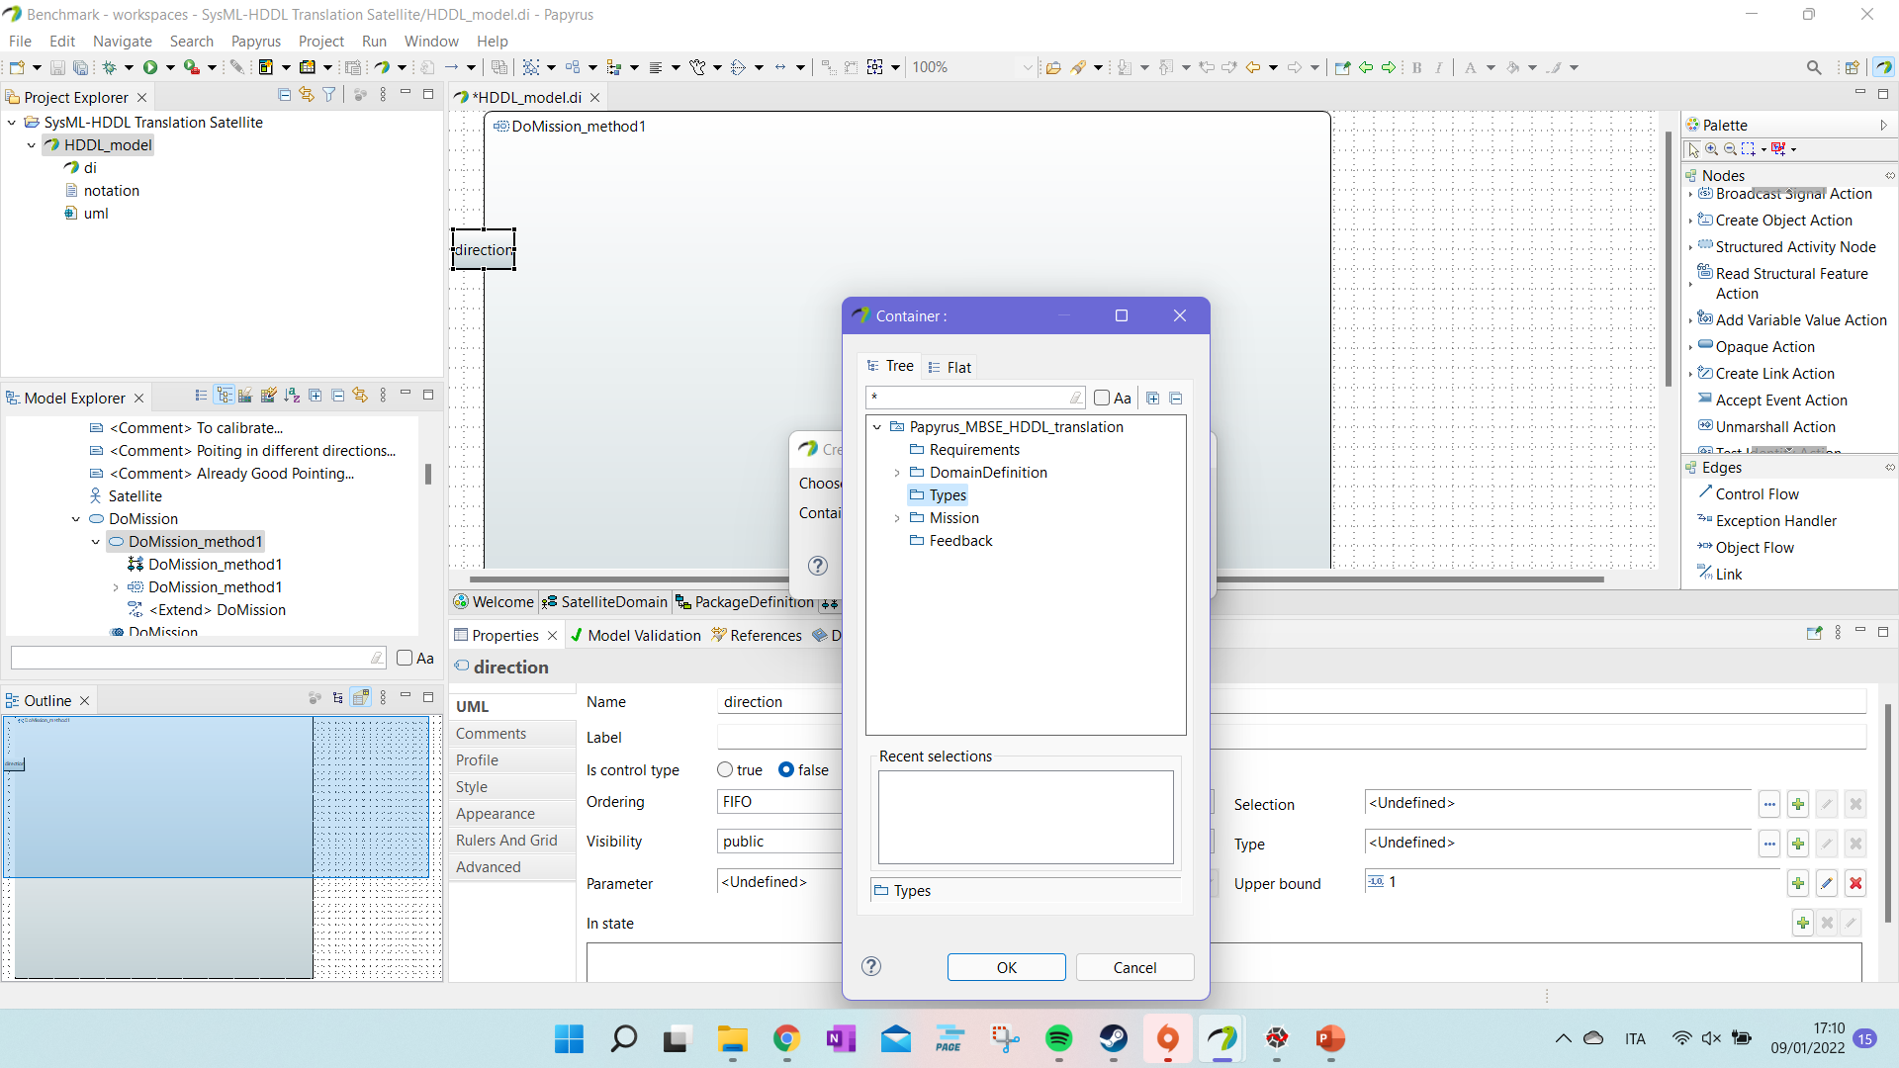
Tutorial: Define Methods (iv)
We save the new “:type” in the “Types” packages.

Slide 29
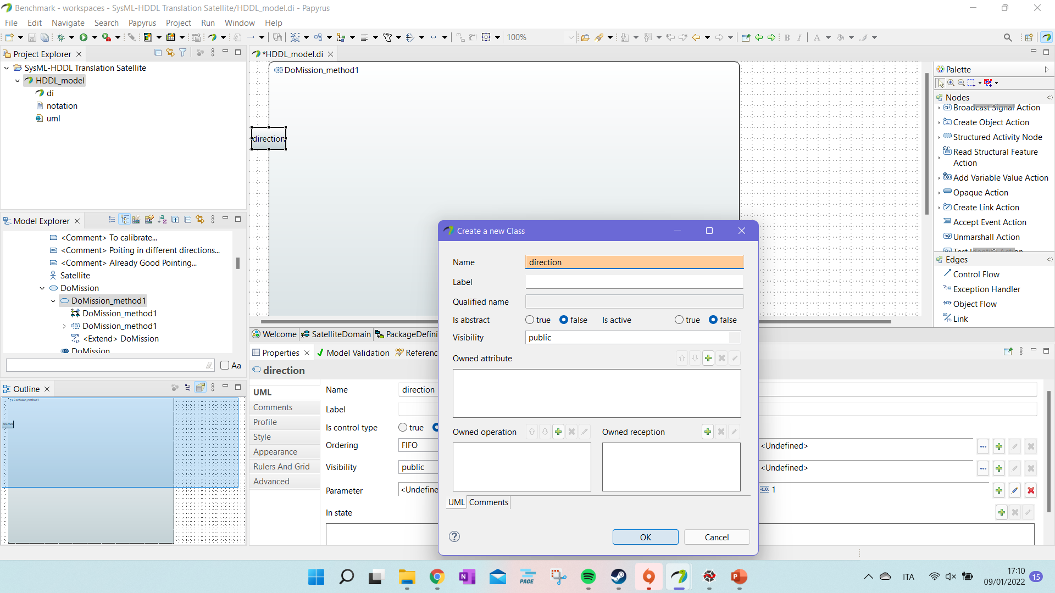
Tutorial: Define Methods (v)
We give the “:type” a name and press “OK”.

Slide 30
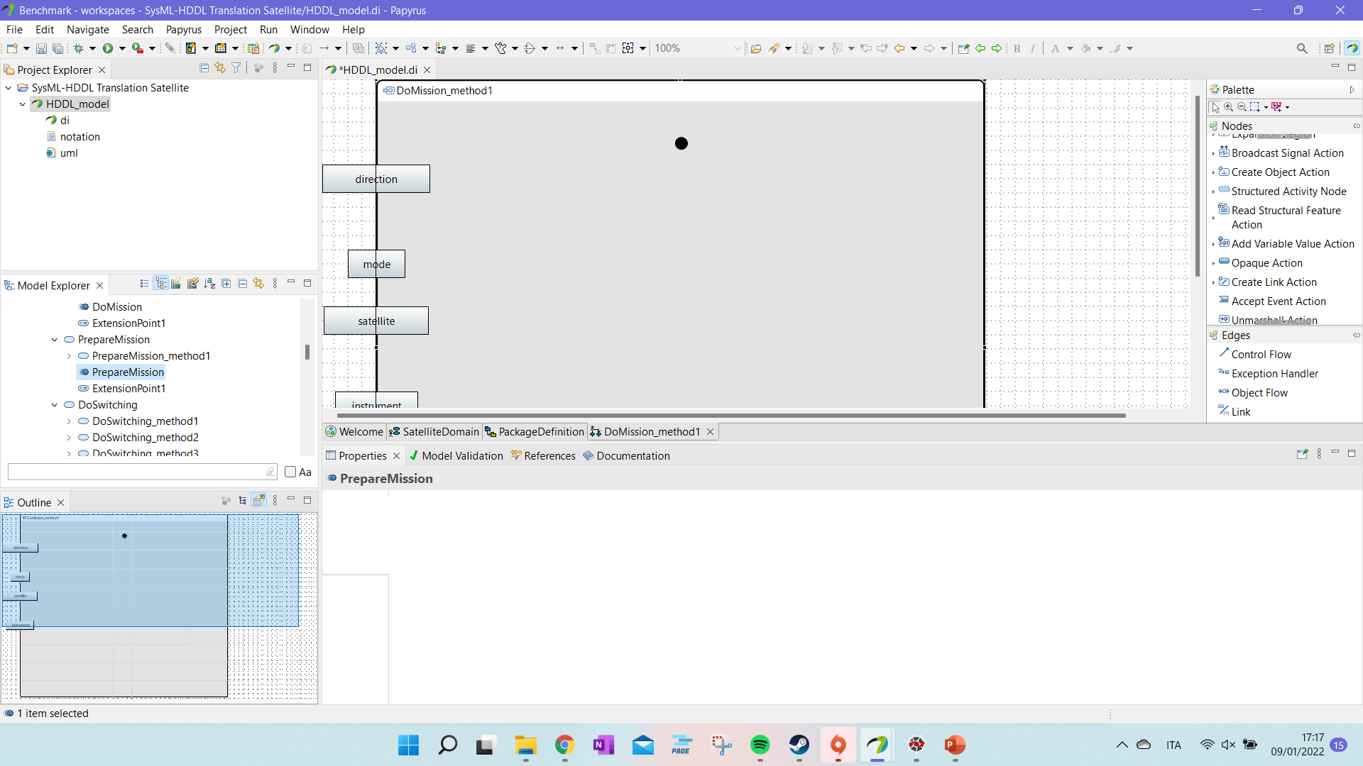
Tutorial: Define Methods (vi)
We start defining the :substasks in the methods.

Slide 31
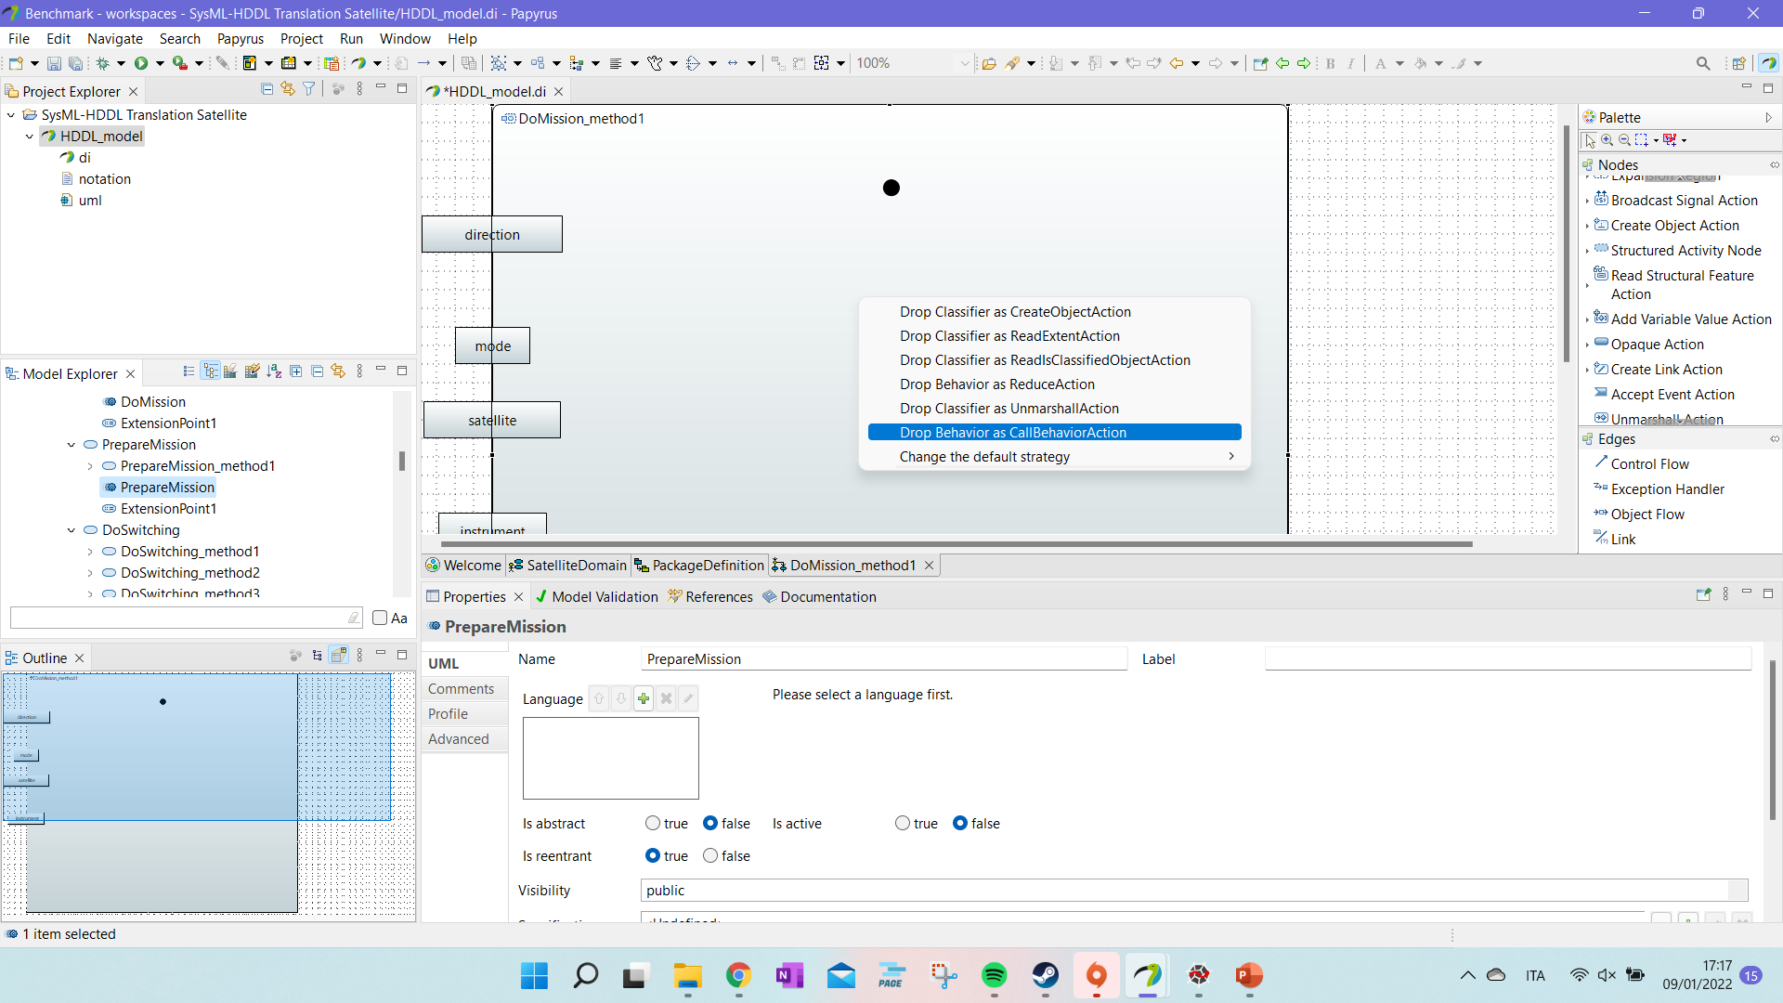
Tutorial: Define Methods (vii)
If we have the use another :task, just slide the OpaqueBehavior in the activity and select “CallBehaviorAction”.

Slide 32
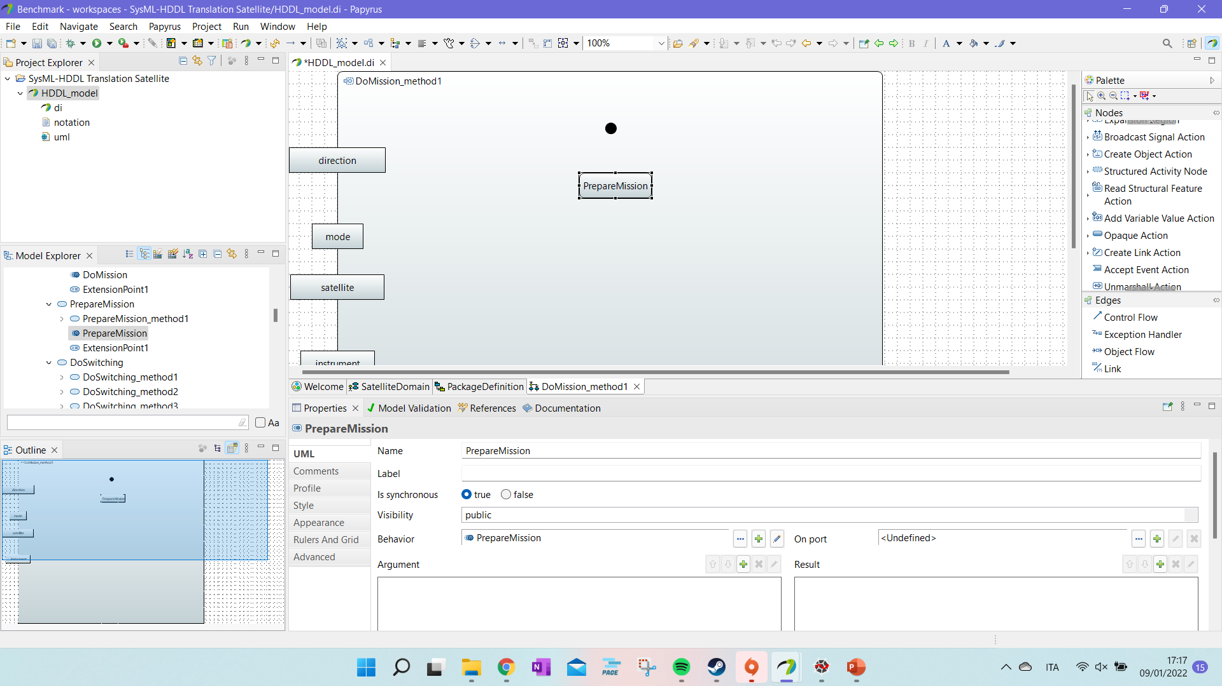
Tutorial: Define Methods (viii)
If we have the use another :task, just slide the OpaqueBehavior in the activity and select “CallBehaviorAction”.
The behaviour is associate to our :task. The name of the element should be the one of the initial task.

Slide 33
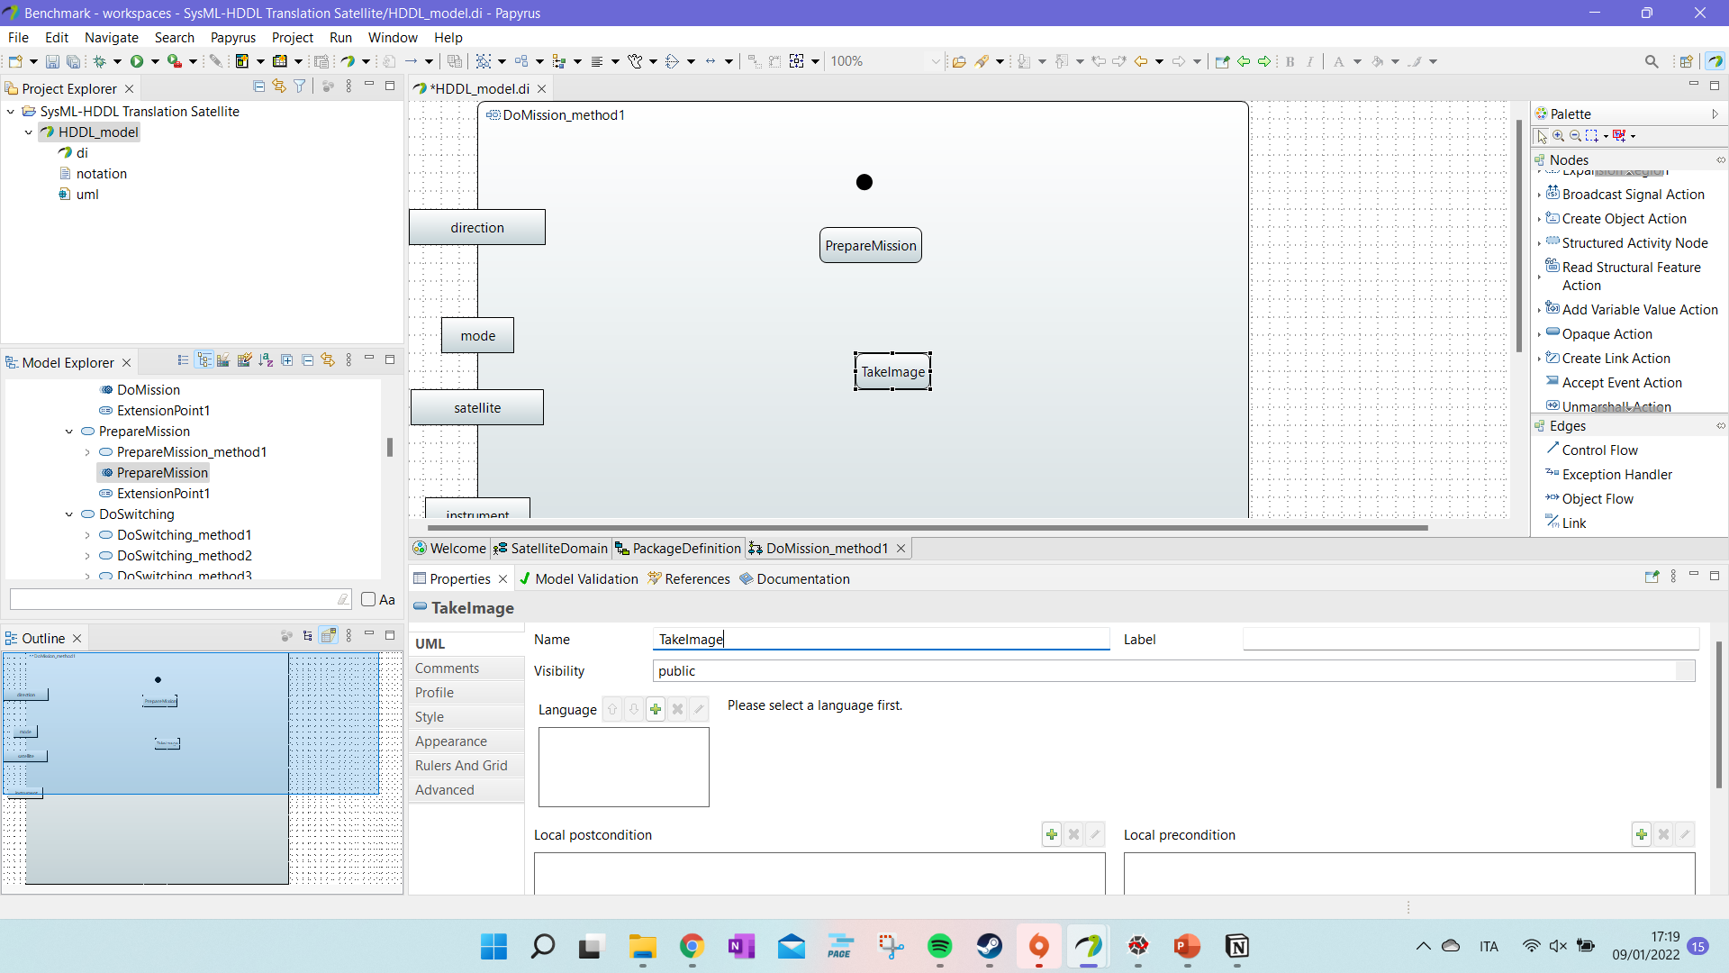
Tutorial: Define Methods (ix)
We then build our activity diagram.

Slide 34
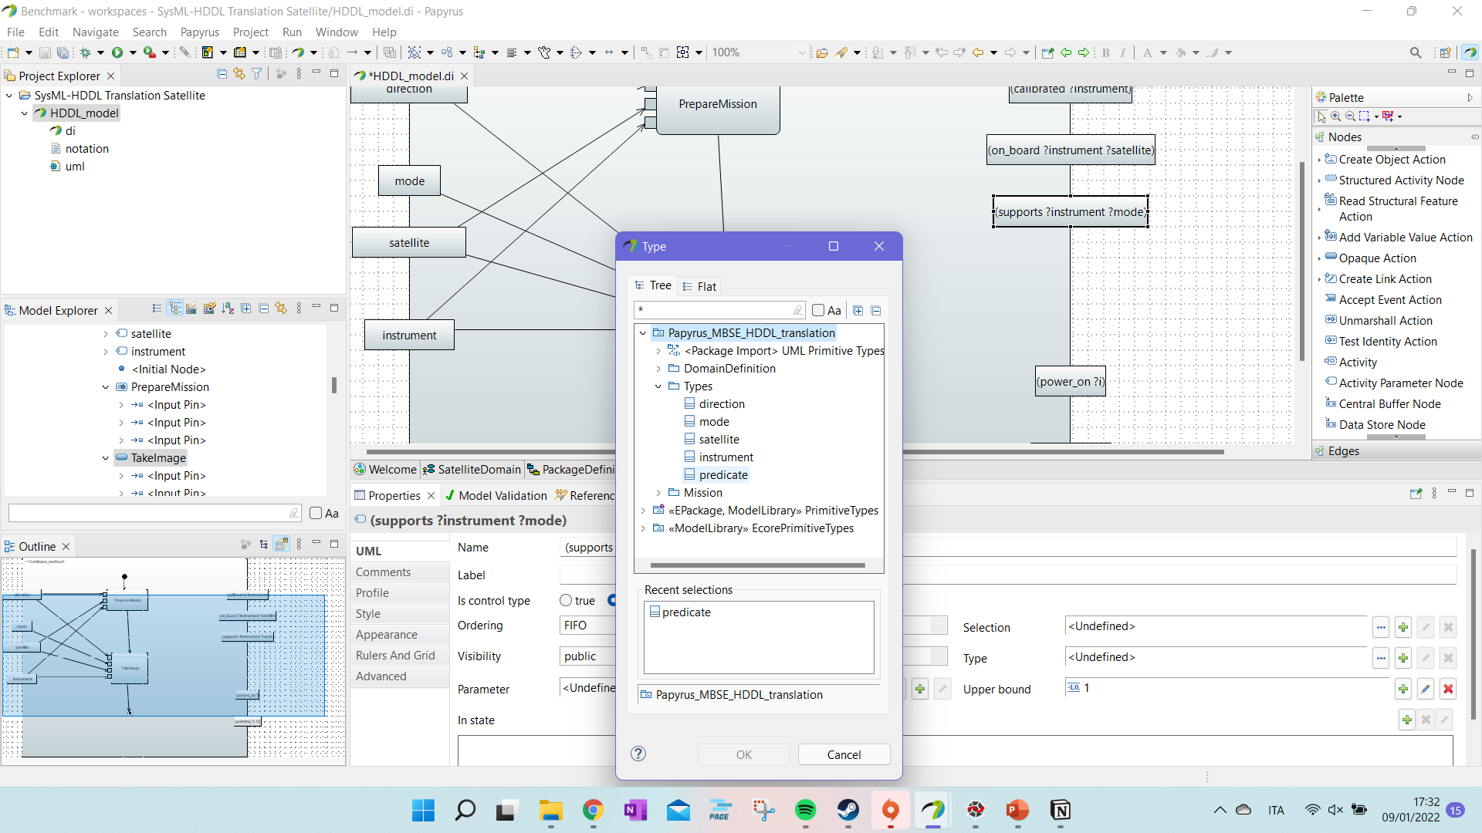
Tutorial: Define Methods (x)
We then build our activity diagram.
We can add the effects of the action and link parameters and effect to the :substask in the diagram.
We can associate the predicates to the «predicate» type – however, it is not necessary. The program will give warnings.

Slide 35
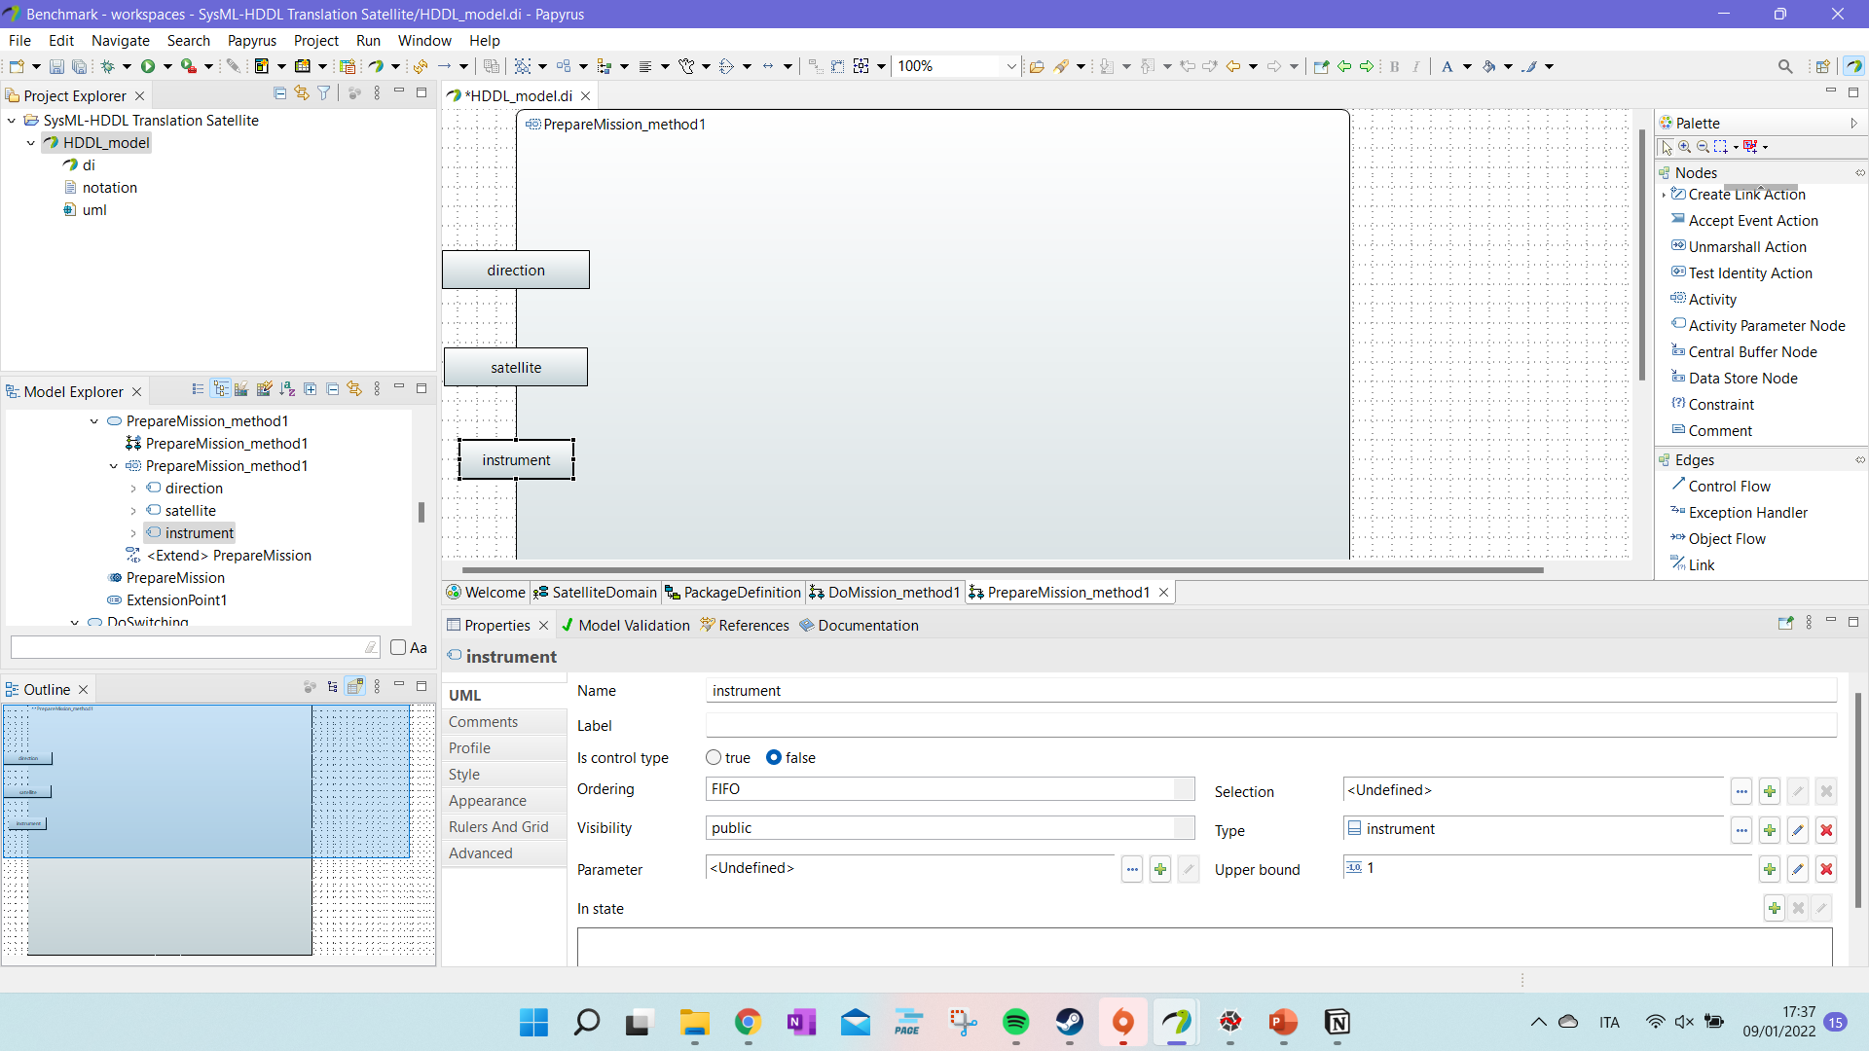
Tutorial: Define Methods (xi)
To avoid writing errors, we can just copy and paste the input of one activiy in another one. And then, slide them on the diagram.

Slide 36
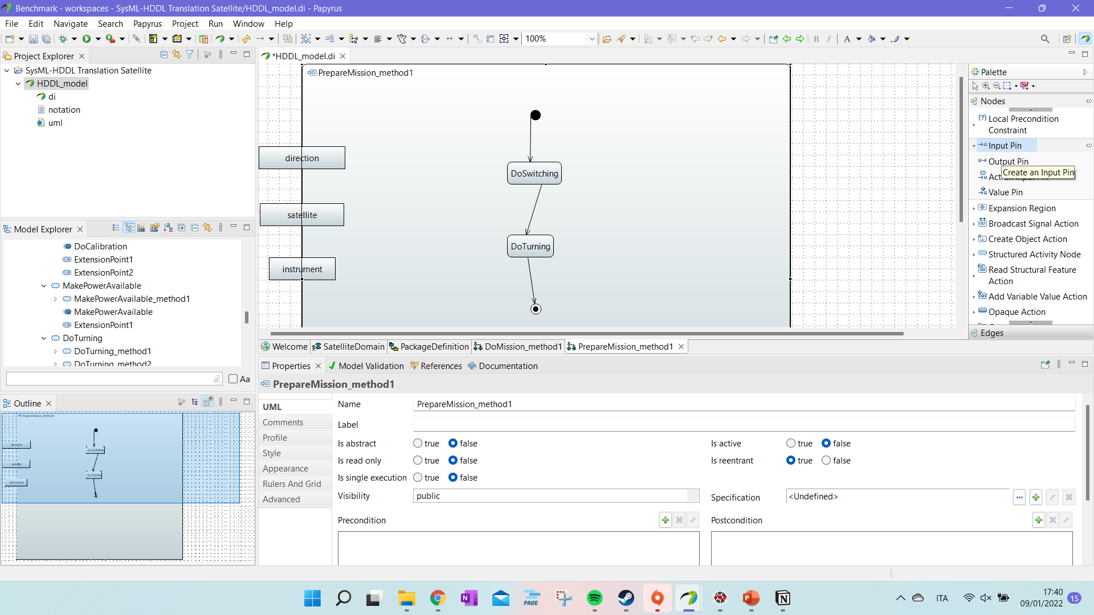
Tutorial: Define Methods (xii)
It is possible to directly connect the :subtask to the input with the edge in “Edges” named “Object Flow”. If that do not work, we can add Input and Output pins to the task and connect the activity parameters to those pins.

Slide 37
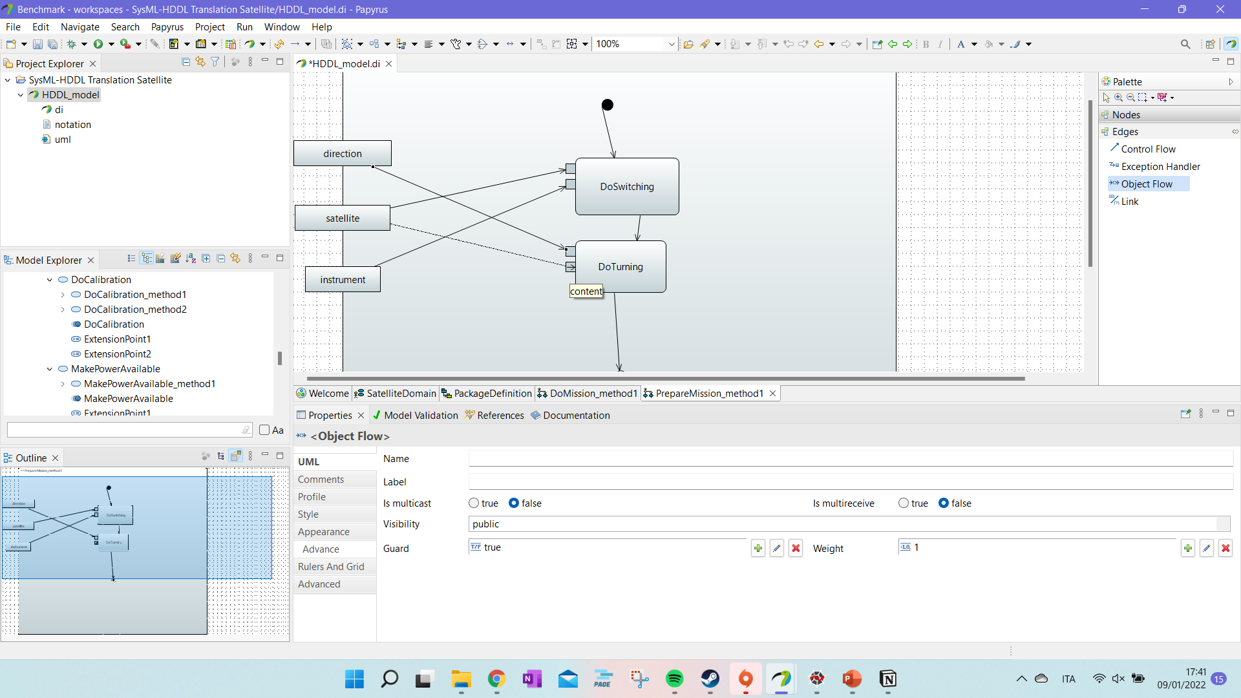
Tutorial: Define Methods (xiii)
It is possible to directly connect the :subtask to the input with the edge in “Edges” named “Object Flow”. If that do not work, we can add Input and Output pins to the task and connect the activity parameters to those pins.

Slide 38
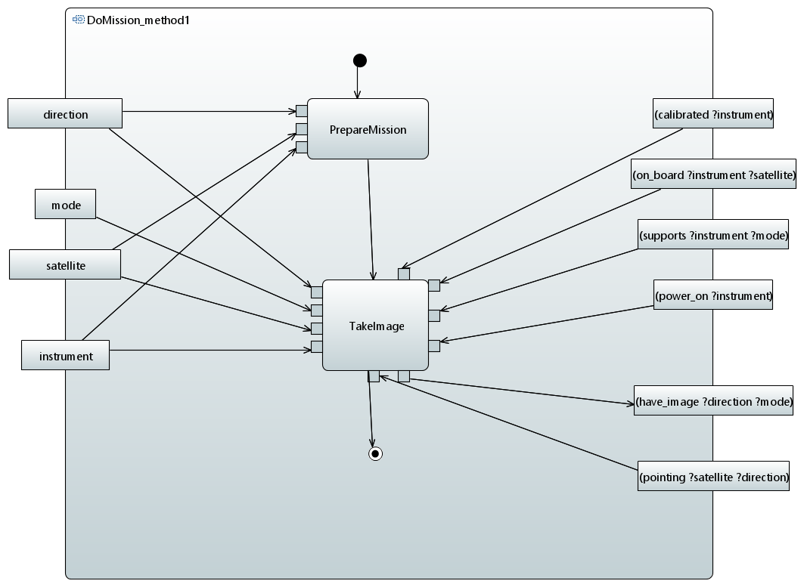
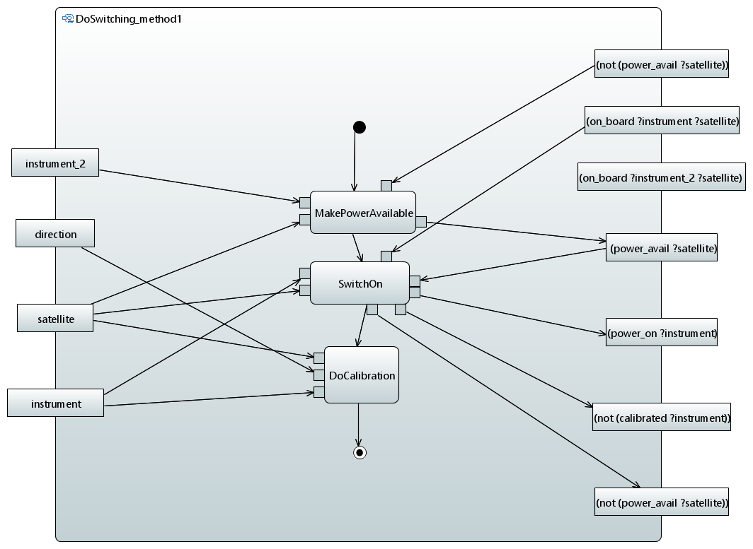
Tutorial: Define Methods (xiv)
You should obtain at the end outputs similar to this diagrams.
You can comment the diagrams for clarity – the comments are not considered in the translation.

Slide 39
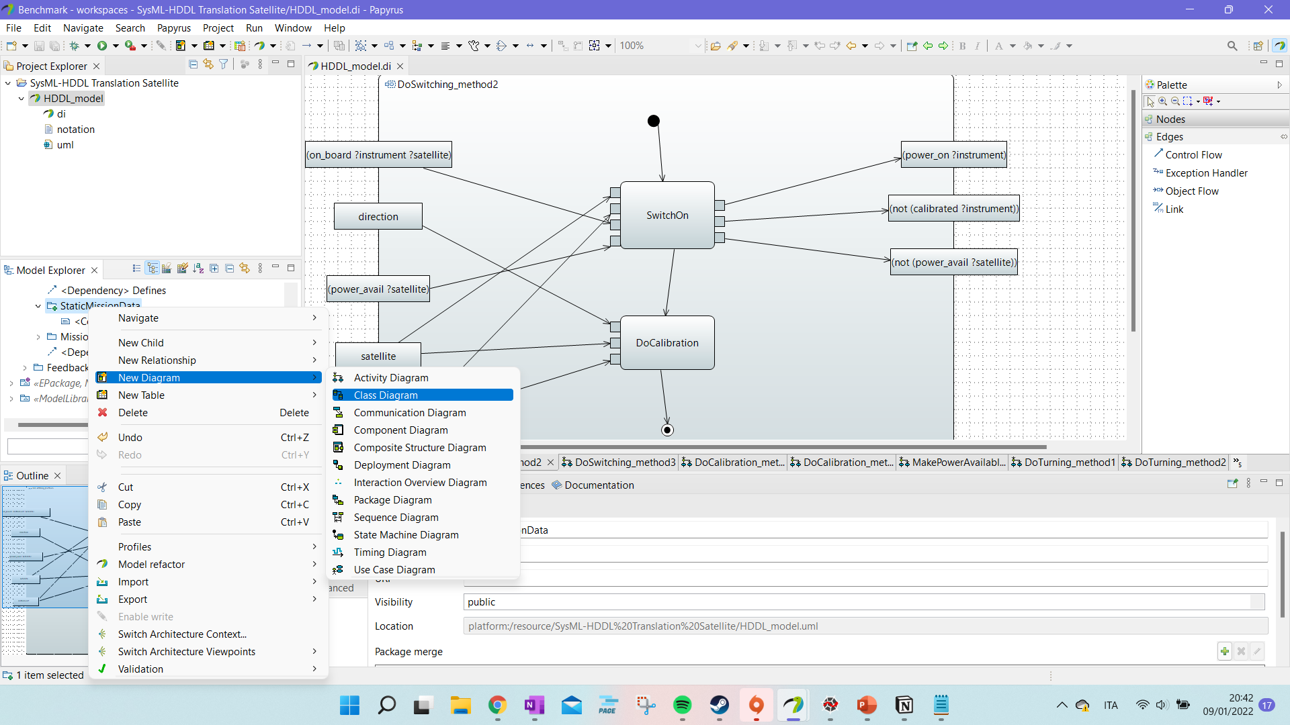
Tutorial: Define Static PF data
Now we can focus on the problem file and define its static data.
We define a “Class Diagram” in the package “StaticMissionData” inside “Mission”.

Slide 40
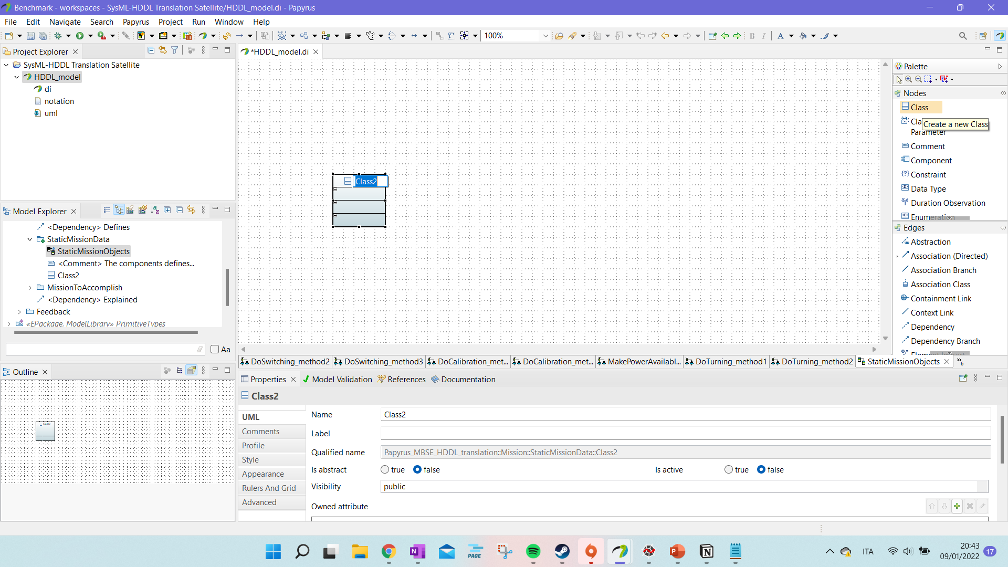
Tutorial: Define Static PF data (ii)
We associate a class to each object of our problem file.

Slide 41
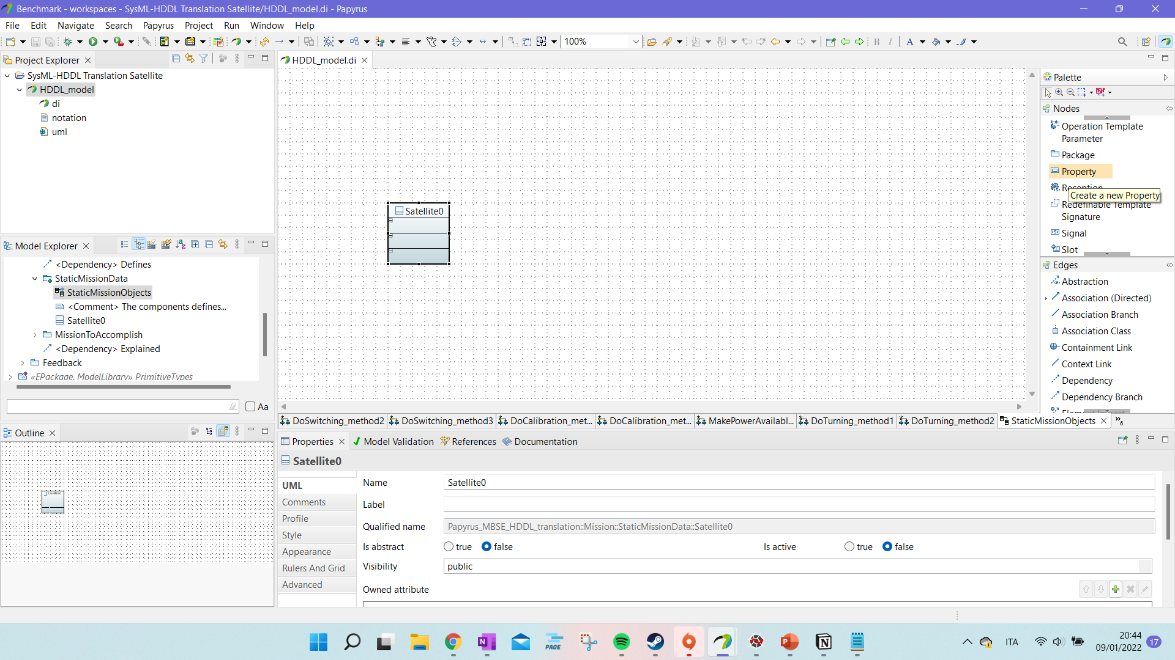
Tutorial: Define Static PF data (iii)
We associate a class to each object of our problem file.
Then we associate a “Property” to this object.
The “Property” specify the type of the object.

Slide 42
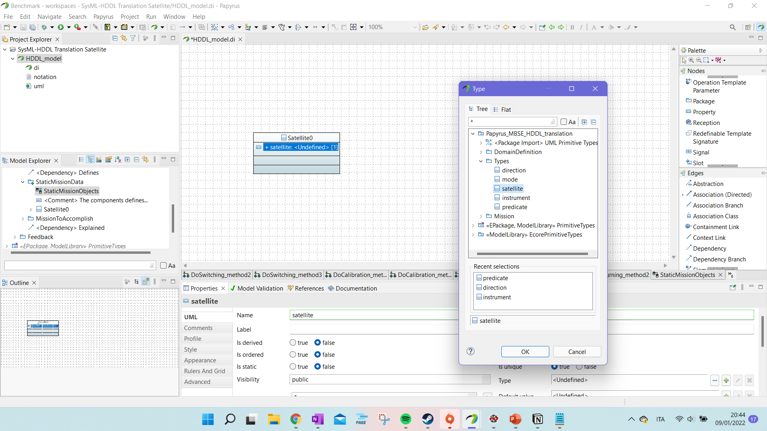
Tutorial: Define Static PF data (iii)
The “Property” specify the type of the object.
We can name the property as we want. The program associate the “Type” of the property to the “:type” of our object.

Slide 43
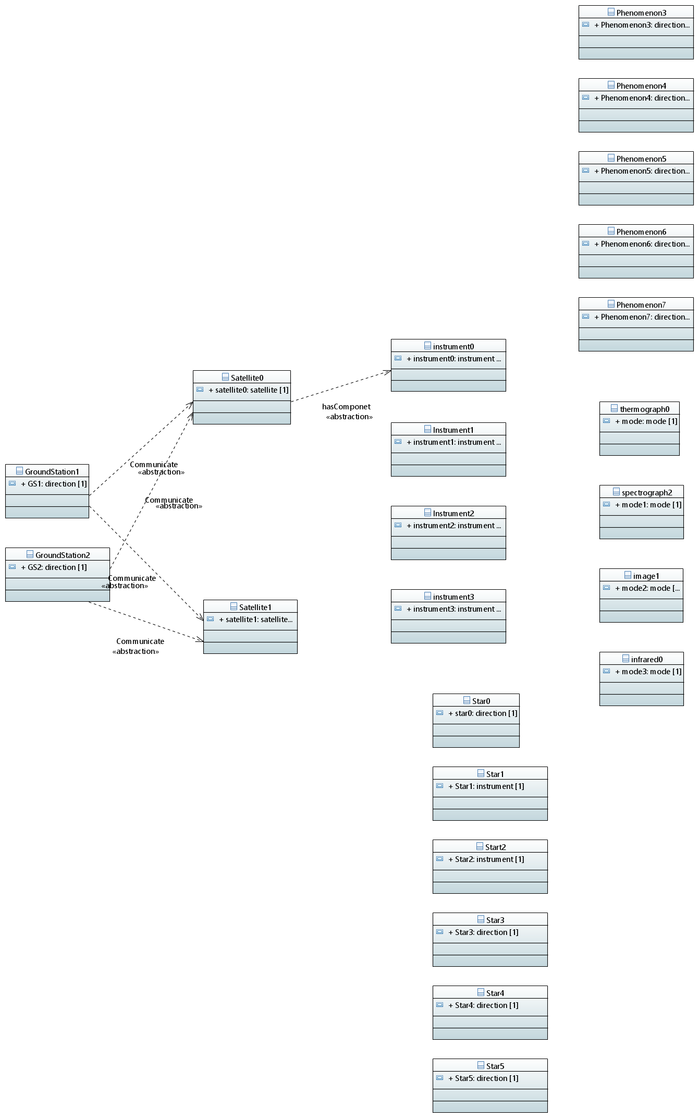
Tutorial: Define Static PF data (iv)
We can have links or comment during the definition of the objects of the problem file to make the diagram clearer. Those comments are not considered in the translation.

Slide 44
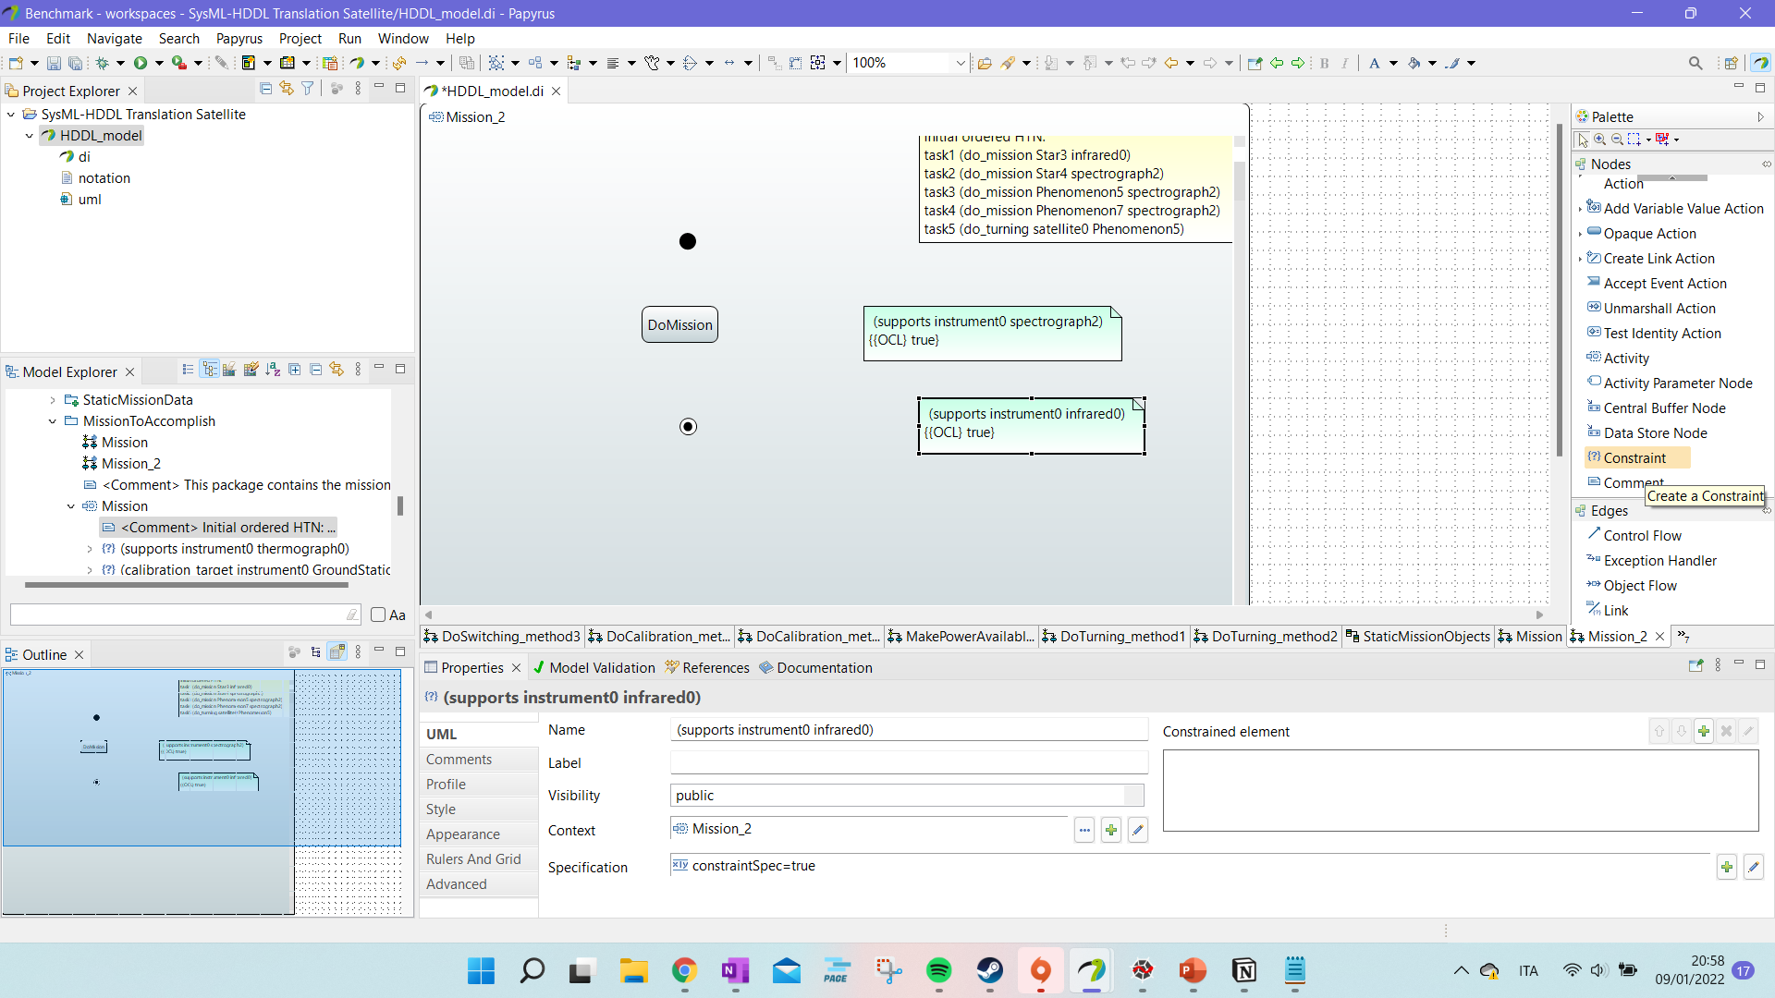
Tutorial: Define mission PF
Inside “MissionToAccomplish” in “Mission” we can defile different “Activity Diagrams” where we specify a possible ordering for the tasks and the initial conditions of the problem file.

Slide 45
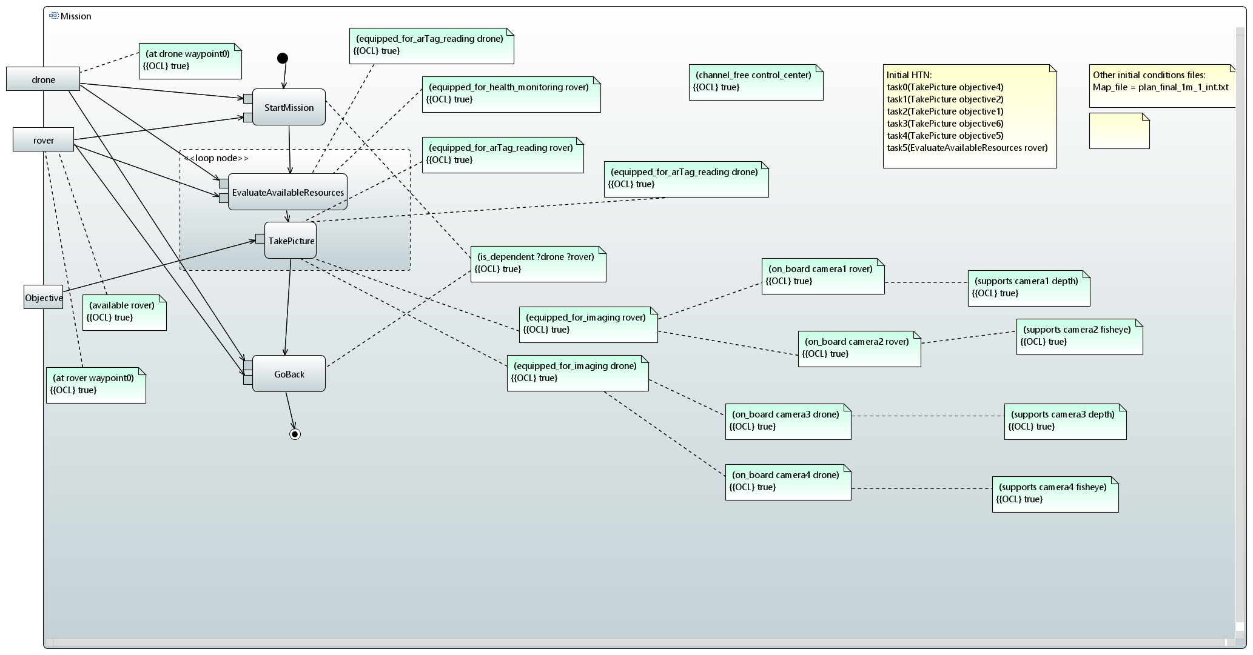
Tutorial: Define mission PF (ii)
The initial HTN is defined as a comment. The world “HTN” is used to find that particular comment.
In the case of IGLUNA, we defined an external file with more objects and conditions. The program reads and try to insert as initial conditions entries in “Other initial conditions file”. However, this has been tested only for IGLUNA. It must be improved. The key word is “file”. If there is a “file” and then an “=” in the line, what is after the = is considered the name of the file and the program search for it in “inputs”.

Slide 46
Tutorial: Define mission PF (ii)
The initial HTN is defined as a comment. The world “HTN” is used to find that particular comment.
If nothing is specified, the program reads the specific order in the mission and use it to give an order to the HTN network.
The constraints can be just listed – the connections help the designers setting up their initial conditions.

Slide 47
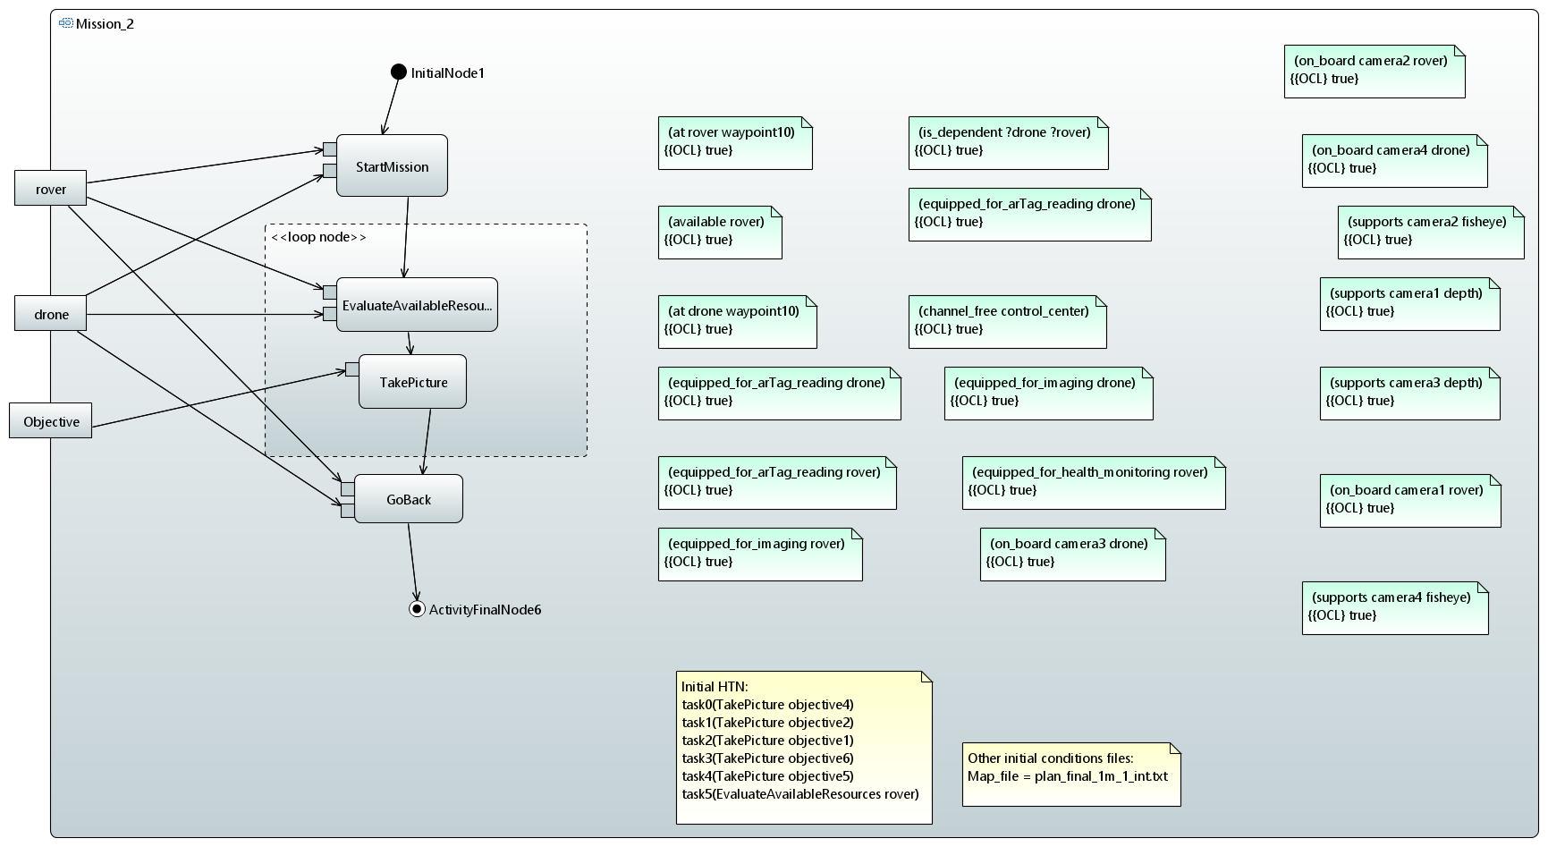
Tutorial: Define mission PF (iv)
The constraints can be just listed – the connections help the designers setting up their initial conditions.

Slide 48
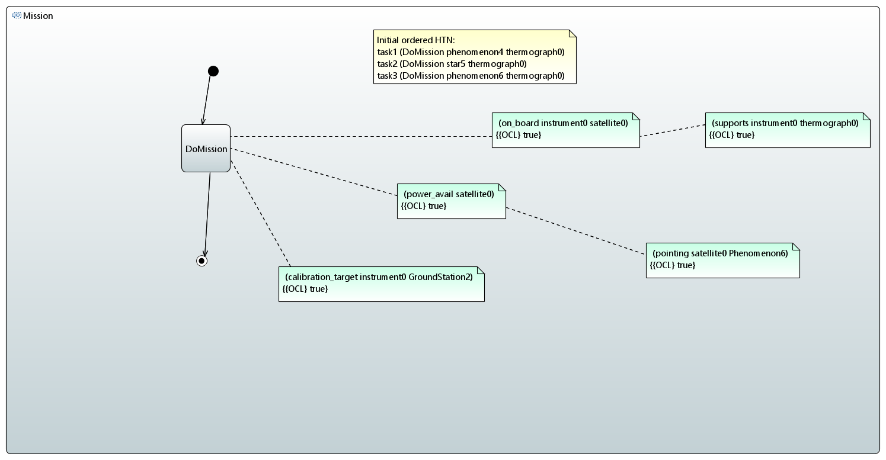
Tutorial: Define mission PF (iii)
If the HTN network in the comment has the word “ordered” in it. The program considers that those are already ordered tasks.

Slide 49
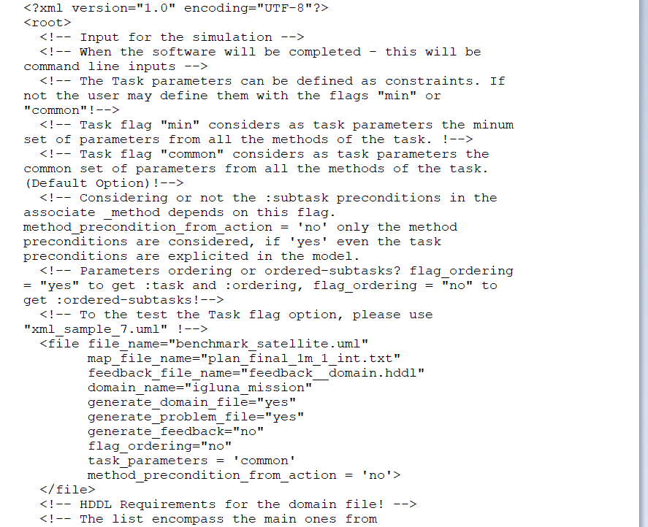
Tutorial: Simulation parameters
The simulation parameters can be set through the configuration file.
We can define how the task inputs are defined. And if we want :subtasks + :ordering or directly :ordered_substasks in our output domain file.
We can define if we want to consider the :subtasks preconditions in the method or not with “method_precondition_from_action” flag.

Slide 50
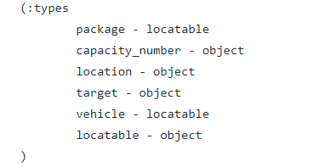

Tutorial: Addendum on Types
When we have classes dependent by others – we can create containment links in a class diagram.

Slide 51
Thank you for your kind attention!!!
Jasmine ☺

